Slide 1
ADVOCACY:
CLOTHESLINES AND PROMISES
Denise Parrish
District 12 Advocacy Chair
parrishzonta@gmail.com
(307) 286-1463

Slide 2
Presentation Topics
The Clothesline Project
https://www.theclotheslineproject.org/
  Raises awareness about Violence Against Women
  If you are uncomfortable with this, or are triggered by the presentation, please feel free to leave
Pledges
  Engaging Women AND MEN to pledge to End Violence Against Women
  NOTE: I WOULD LIKE THE CLUBS TO PICK ONE OF THESE TWO PROJECTS (OR BOTH PROJECTS) TO DO THIS YEAR AS ONE OF THEIR ADVOCACY ACTIVITIES

Slide 3
The Clothesline Project: The Catalyst
58,000 soldiers died in the Vietnam War.
51,000 women were killed – mostly by men who supposedly loved them – during that same period of time.
Based on those statistics, a coalition of women’s groups on Cape Cod decided to develop a program that would educate, break the silence, and bear witness to Violence Against Women. (Summer, 1990)
Many of the women had experienced personal violence.
They wanted a unique, provocative “in-your-face” educational and healing tool.

Slide 4
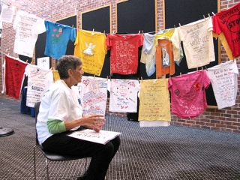
Who was Rachel Carey-Harper?
Visual artist – inspired by the AIDS Quilt
Suggested using shirts, hanging on a clothesline
Laundry was women’s work
Women often exchanged information over backyard fences
Each woman told her story in unique way – using word and/or art
She would then hang her shirt on the clothesline
Cape Cod Community College sponsored a Clothesline Project display and lecture in April 2012. CP founder, Carol Chichetto, is shown here speaking at the event to several classes at the College.

Slide 5
The First Exhibit
October, 1990 with 31 shirts
Hyannis, MA on the village green
Part of “Take Back the Night” march and rally
Throughout the day, women came forward to create the shirts – and the line kept growing.
A small blurb appeared in Off Our Backs magazine – it was picked up by Ms. Magazine, and they were off and running.

Slide 6
Why Art? Why Shirts?
Each person can tell her story in her own way.
It becomes an educational tool for those who view it.
It becomes a healing tool for those who make the shirt.
It allows those suffering in silence to understand they are not alone.
Art therapy began formally after WWII, continues to be widely adopted to help battered women and children deal with their physical and emotional scars.
When the healing kicks in, it restores a sense of possibility, identity, and reconnection with parts of oneself that were silenced in order to survive the violence.

Slide 7
Art and Violence Against Women
Excerpt from
Telling without Talking and Domestic Violence:
Art Breaks the Silence of Domestic Violence
While art is not the panacea for abuse, it is certainly a way through it and one that not only transforms the atrocities of violence, but also sends a powerful message that ultimately breaks the silence.
Cathy Malchiodi PhD
Psychology Today
Posted September 26, 2008

Slide 8
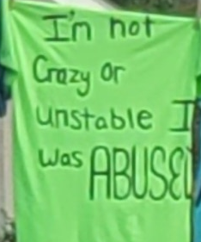
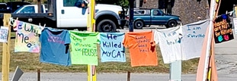
Oak Ridge, Tennessee (2023)

Slide 9
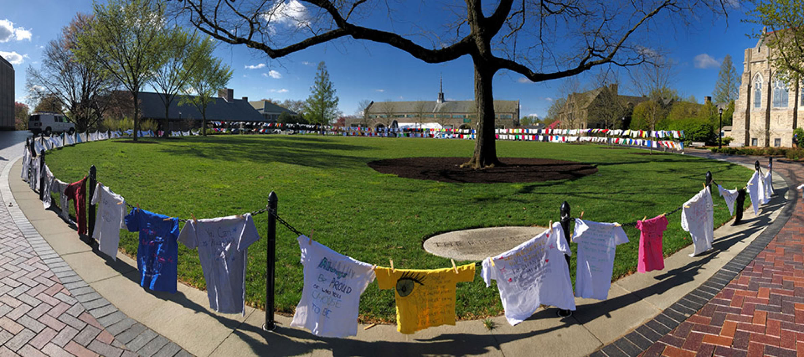
Villanova 2022

Slide 10
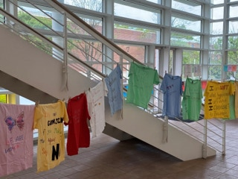
Columbia College, South Carolina 2023

Slide 11
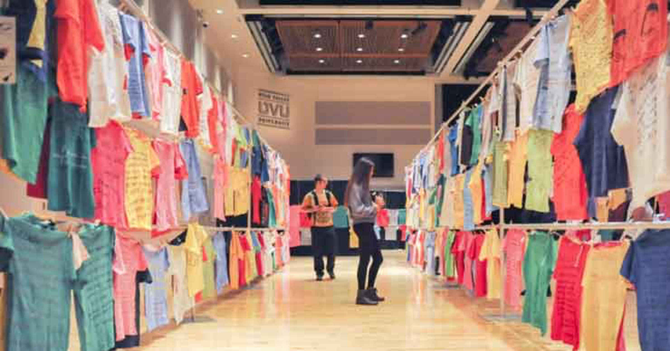
Utah Valley University
The Clothesline Project has been displayed at Utah Valley University each year since 1998. In recent times, about 30-50 shirts are added to its collection annually. It is estimated it has over 2,000 shirts in total.

Slide 12
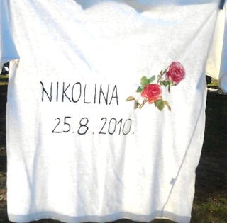
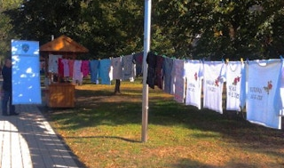
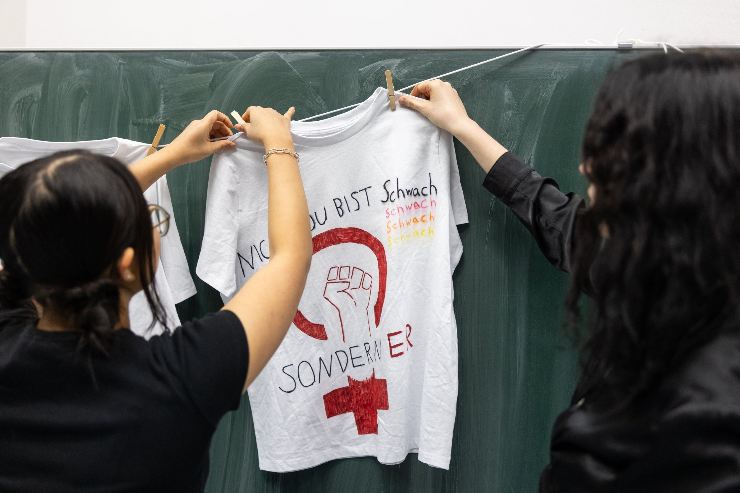
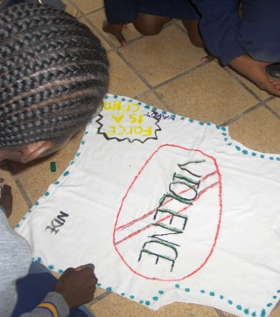
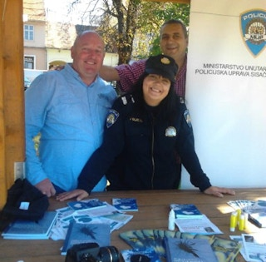
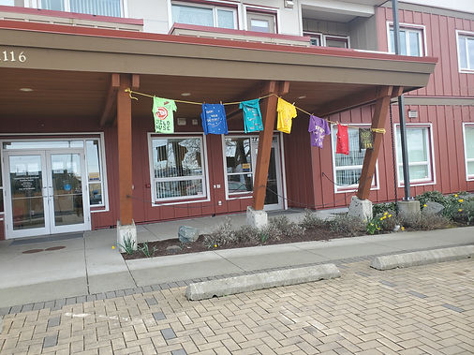
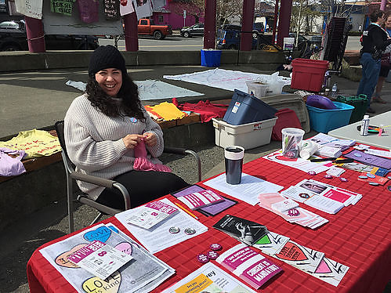
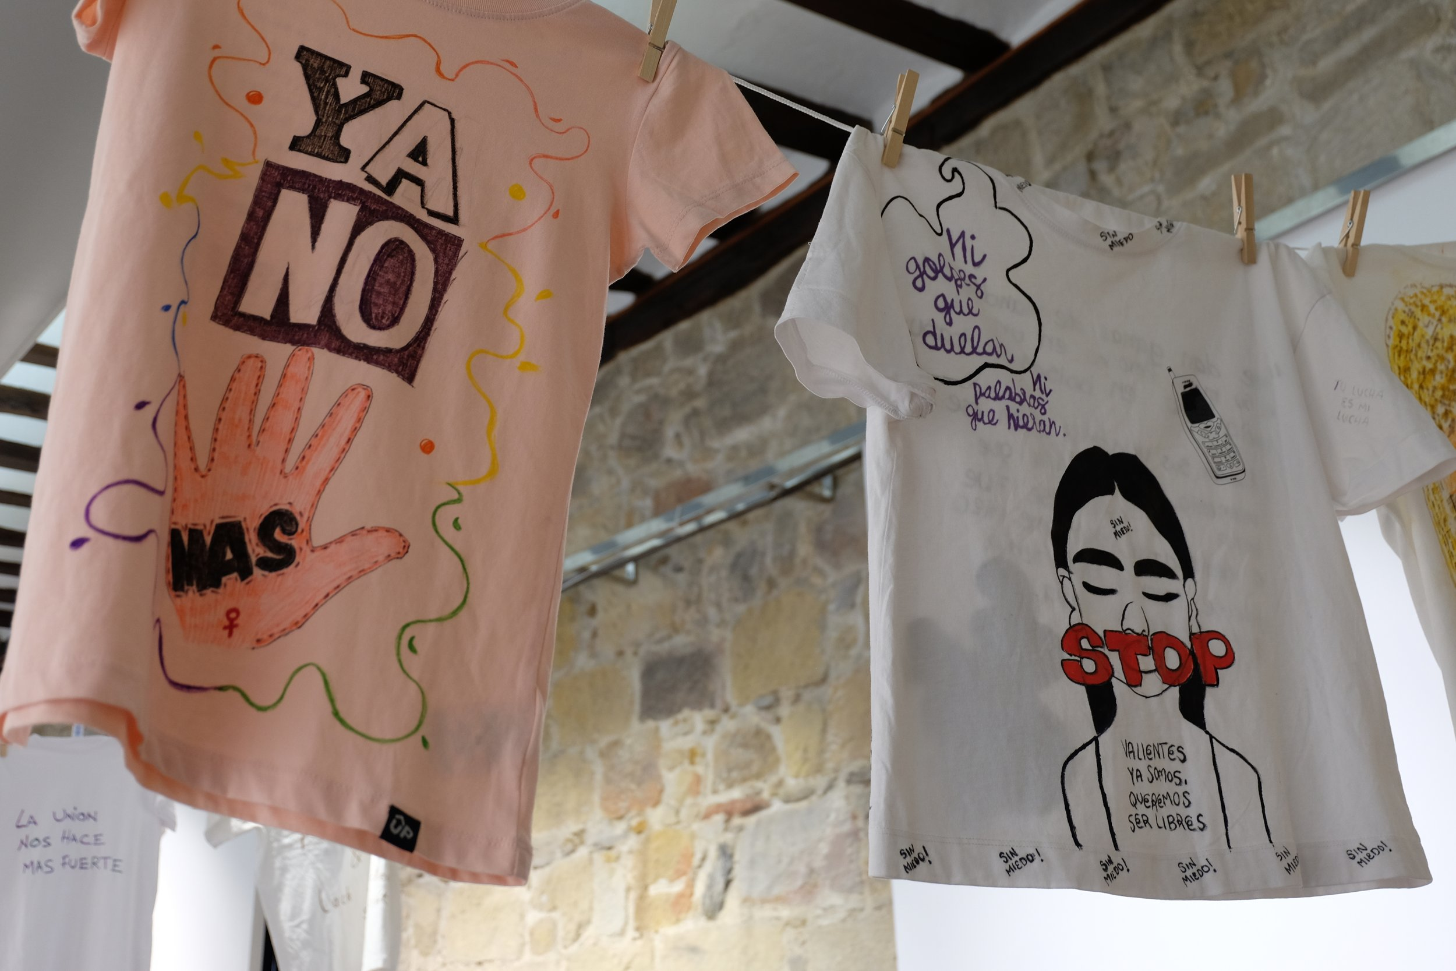
The Clothesline Project is International – A Sampling
Sisak, Croatia
Münster, Germany
Etosha, Namibia
British Columbia, Canada
Bilboa, Spain

Slide 13
Who Should Create a Shirt?
Anyone who has experienced intimate violence
Victim’s or survivor’s family and friends
Survivor = A person (generally a woman) who has survived intimate personal violence such as rape, battering, incest, child sexual abuse\
Victim = A person (generally a woman) who has died at the hands of her abuser.

Slide 14
Writer’s Block – What do I Say?
Messages of HOPE for the elimination of violence against women and children
Messages of ACCOUNTABILITY and hope for change for perpetrators of family violence
Messages of EDUCATION about the impact of violence against women and children
Messages of PROTEST about the prevalence of violence against women

Slide 15
Clothesline Project Boundaries
Violence Against Women must be the foundation and focus of all Clothesline Project events or projects.
Only shirts are to be used – no other types of clothing
Do not name the perpetrator on the shirts
There can be no charge or fee required at any of the events or projects.
  If associated with another activity, it is to be made clear that the fee is not associated with the Clothesline Project portion of the activity.

Slide 16
Clothesline Project Suggestions
Shirt Color Codes – No longer mandatory
  White – Someone died because of violence
  Yellow – Survivor of physical assault or domestic violence
  Red, Orange, Pink – Survivor of rape or childhood sexual abuse
  Blue, Green – Survivor of incest or childhood sexual abuse
  Purple – attacked because of their sexual orientation
  Brown, Gray – Survivor of emotional, spiritual, or verbal abuse
  Black – Someone disabled as the result of an attack or someone assaulted because of a disability
E-Mail full size photos after the completion of the project to webmaster@theclotheslineproject.org
  Include photos of overall project and individual shirts
  Include basic facts of when/where/who
Have referral information to local crisis/counseling centers on hand

Slide 17
PLEDGES
Raises awareness of the issue of Violence Against Women
  It is only the start of making change.
  Advocates must not let this be “performative allyship” that does not require meaningful action.
Recognizes that the cultural norms will not change until Men are engaged in the solution to ending Violence Against Women
Promotes Bystander Intervention.
April 2012, NSA Bahrain Coalition of Service Members Against Destructive Decisions

Slide 18
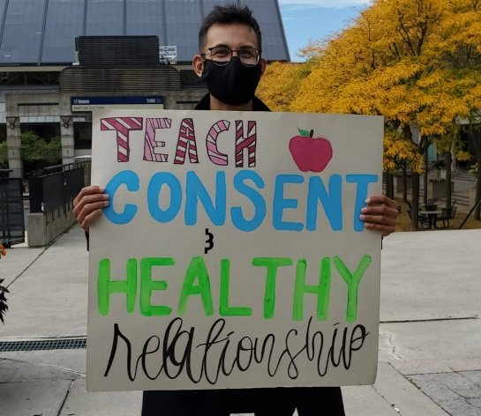
WHITE RIBBON CAMPAIGN (CANADA)
White Ribbon is committed to building a world free of all forms of gender-based violence and discrimination.
White Ribbon promotes healthy masculinities, advances gender equity and builds allyship.
Goals
  Build allyship to help end gender-based violence and discrimination locally, nationally and globally
  Lead transformative culture change through programming and initiatives
  Strengthen our ability to achieve our mission

Slide 19
White Ribbon Pledge
I pledge to never commit, excuse, or stay silent about sexual harassment, sexual assault or domestic violence against others.
And to show that I really mean it, I promise to:
  Talk to a younger man in my life about consent.
  Share feminist calls to action and news on social media.
  Support women’s organizations and shelters that provide services to survivors of violence.
  Ask my peers to not use sexist or violent language when referring to women.
  Create safe and supportive spaces for the women in my life by practicing active listening.
  Encourage and support gender equality initiatives at work.
  Talk to men in my life about why gender equality is important and how they can play an active role.
  Make my own plan of action.

Slide 20
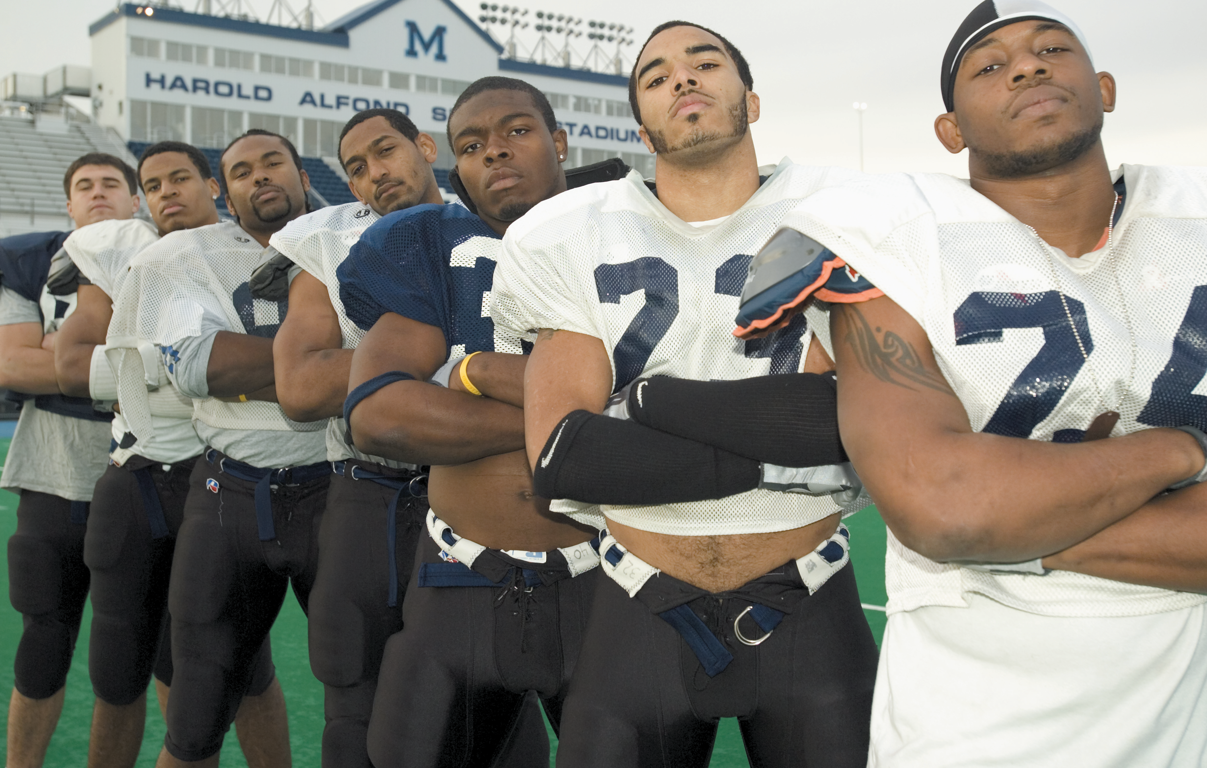
University of Maine
Male Athletes Against Violence
Violence is a way of asserting power, privilege, and control.
Men perpetrate the majority of violence, and yet, this issue is usually framed as a “woman’s issue.”
Change will come when we challenge the social norms and institutions that actively or implicitly condone and promote violence.
Male Athletes Against Violence is an effort to involve men so that we can begin to understand that violence is very much a “man’s issue.”

Slide 21
University of Maine MAAV Pledge
I pledge:
to educate myself on issues surrounding violence while developing personal beliefs against the use of violence
to be a positive role model for my community
to look honestly at my actions in regard to violence and make changes if necessary
to educate others on all issues surrounding violence
to take initiative! I will be prepared and have the courage to correct others regarding violence
to support women’s groups. I may not be able to prevent all violence but I will help those who have been victimized
to be aware of pre-existing beliefs, stereotypes or rumors that may alter my judgements
to challenge the social normin. If no one ever challenges the norm, nothing will change
to learn to identify problematic situations to help victims.

Slide 22
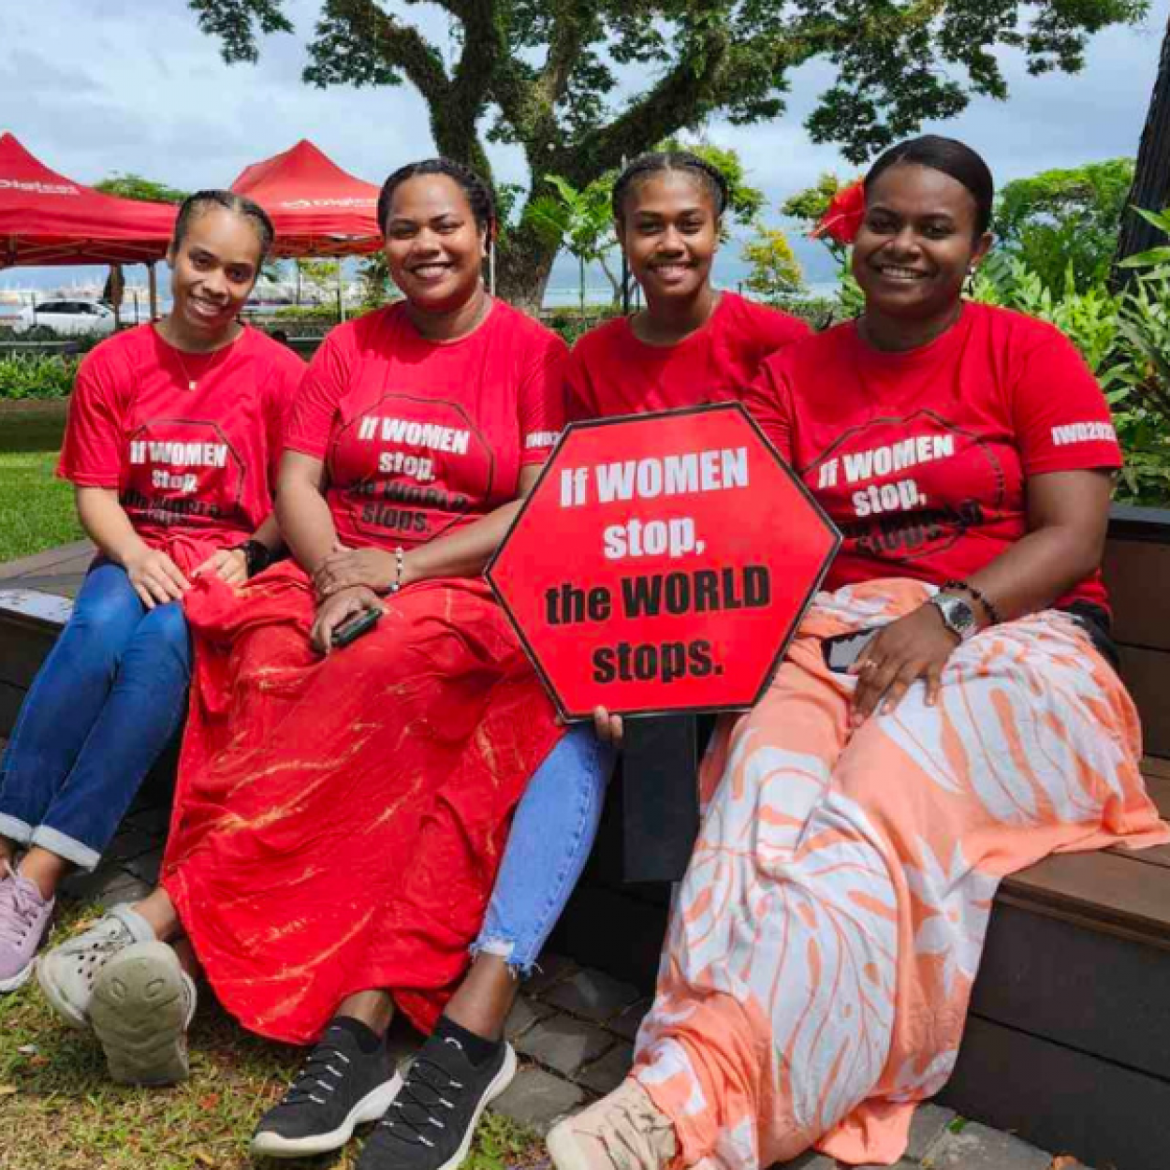
International Women’s Development Agency (Australia)
Founded in 1985 to advance the rights of women and address their absence as beneficiaries of, and decision makers in, development.
Prioritize partnership and respect for women’s capacity, agency and human rights in all areas of development –priorities which remain at the core of our work today.
Work for feminist movements by resourcing diverse women’s rights and aligned organizations, primarily in Asia and the Pacific, with the money, skills and access they need to achieve their priorities.
Over our 30-year history, IWDA has worked with 194 program partners across 36 countries and territories.

Slide 23
International Women’s Development Agency Pledge
Violence against women is a key barrier to women’s leadership. It limits women’s ability to live freely and restricts women’s leadership and voice.
All women and children have the right to be free from physical, sexual, and psychological violence.
Violence against women is never justifiable and can be prevented.
This 16 Days of Activism:
  I pledge to raise MY VOICE to end violence against women.
  I believe that all people are entitled to feel safe and respected.
  I believe that women and men are equal.
  I will use MY VOICE – I will never condone or remain silent about violence against women.
  I will support women who are leading action to prevent and respond to violence against women.

Slide 24
Which Pledge Do You Prefer?
What would you add to your preferred pledge to improve it?

