Slide 1
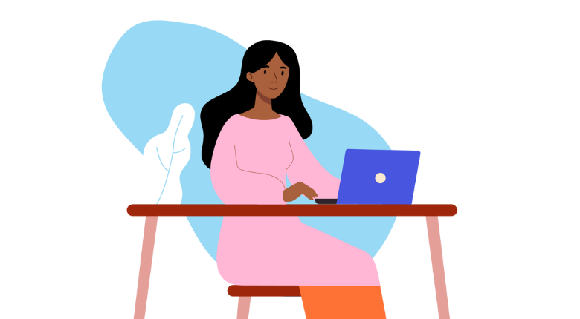
Harnessing Artificial Intelligence to Protect Women and Girls: The Lahaa Approach
Renée L. Coppock
District 12
Zonta Club of Billings

Slide 2
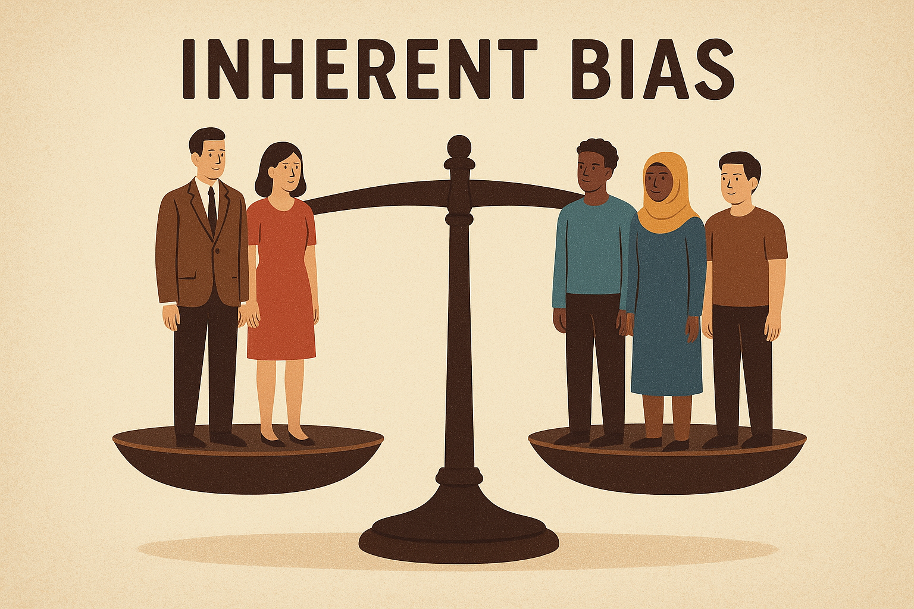
Bias
Explicit bias—refusal to hire a woman simply because she is a woman.
Unconscious or inherent biases — influence without awareness.
Affinity bias: favoring people similar to you.
Confirmation bias: seeking out information that confirms existing beliefs.
Gender bias: assumptions about roles based on sex.
Name bias: favoring certain names over others on resumes.

Slide 3
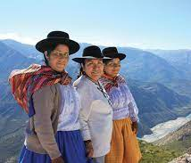
Generative AI is Powerful, But Reproduces Biases.
Women constitute only around 22% of AI professionals globally.
Bias in AI is a societal challenge.
AI is increasingly being used in areas like healthcare, financial services, hiring, policing, and even armed conflicts, if it goes unchecked, it risks reinforcing existing inequalities at a much larger scale.

Slide 4
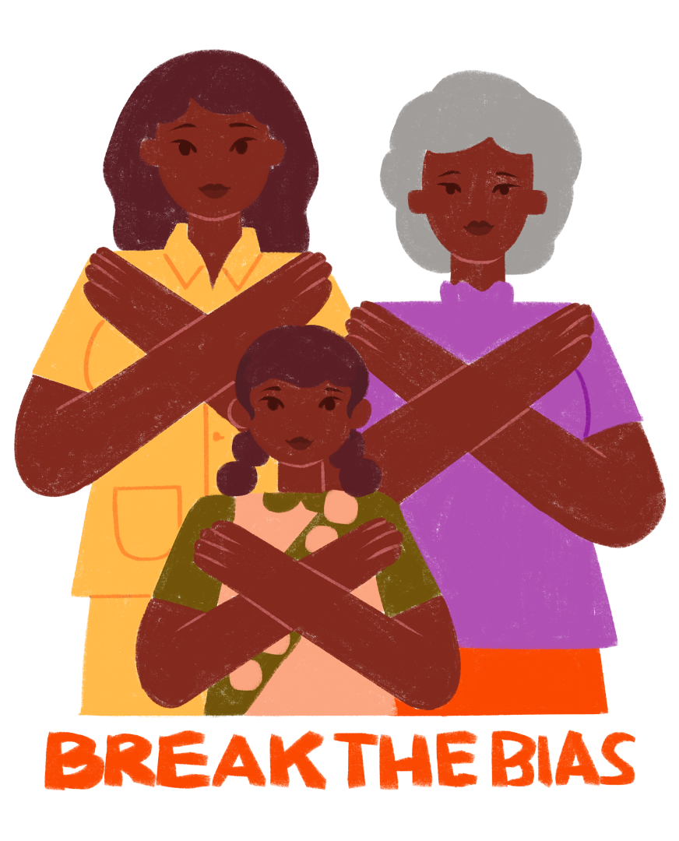
Bias Can Enter AI Systems at Multiple Stages.
Data Collection.
Data Labeling.
Model Training.
Deployment.
Addressing bias requires continuous evaluation, feedback, and correction.

Slide 5
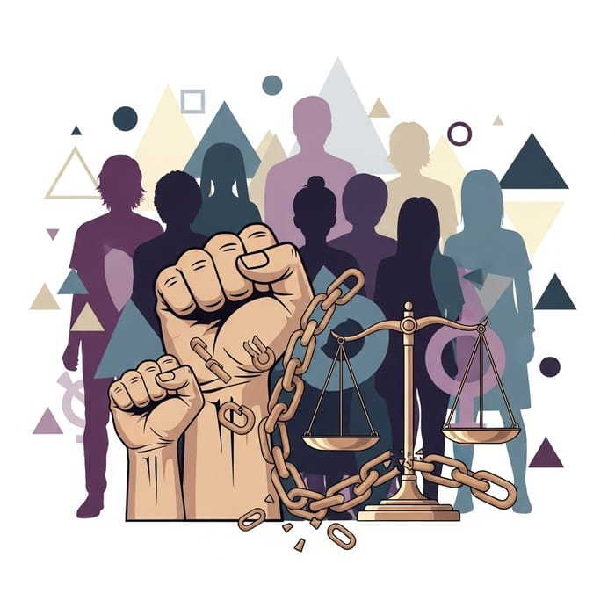
AI Exacerbates Gender-Based Violence.
CEDAW has called digitized violence the “newest category of gender-based violence.”
Violence infiltrates homes and bedrooms, workspaces, and schools.
No geographical boundaries.
Starts online and escalates to physical spaces.
Can end in the most extreme forms of violence, including femicide.
Image courtesy easy-peasy.AI

Slide 6
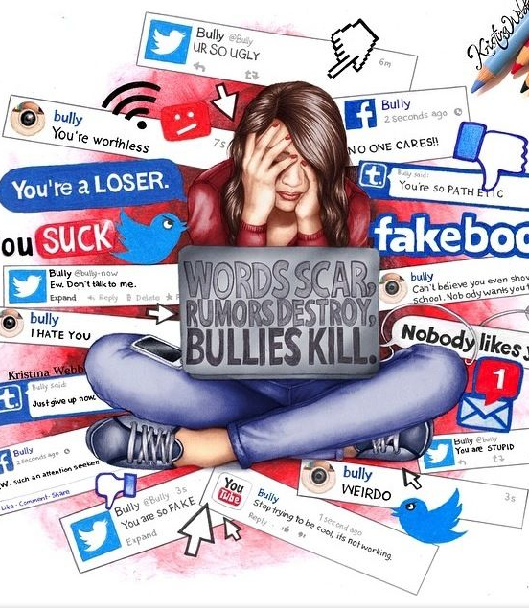
Statistics
2020: 58% of girls and young women experienced some form of online abuse.
2024: 78% of young women experienced some form of harmful online experience.
2024: Nearly 40% of young women harassed online at least once a month and 11% daily.
*Image by Kristin Webb

Slide 7
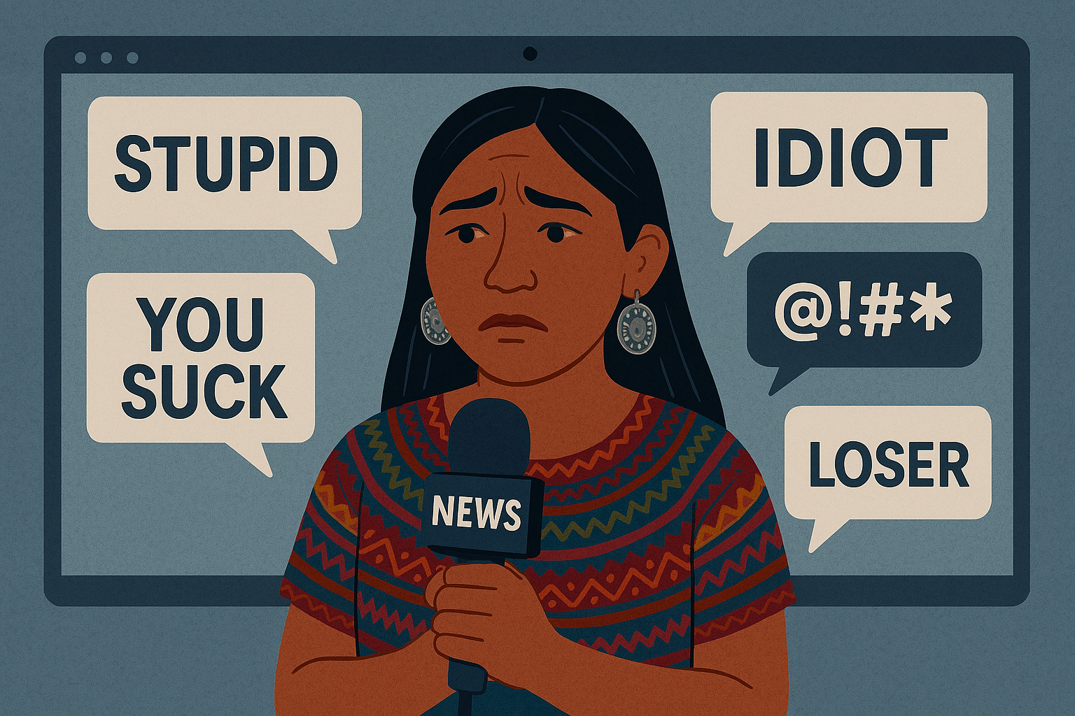
Statistics (cont.)
86% of Indigenous women journalists reported experiencing online violence.
Violence spikes in conflict areas.
Online violence has been experienced by women journalists of all colors around the world.
Women’s voices are silenced.

Slide 8
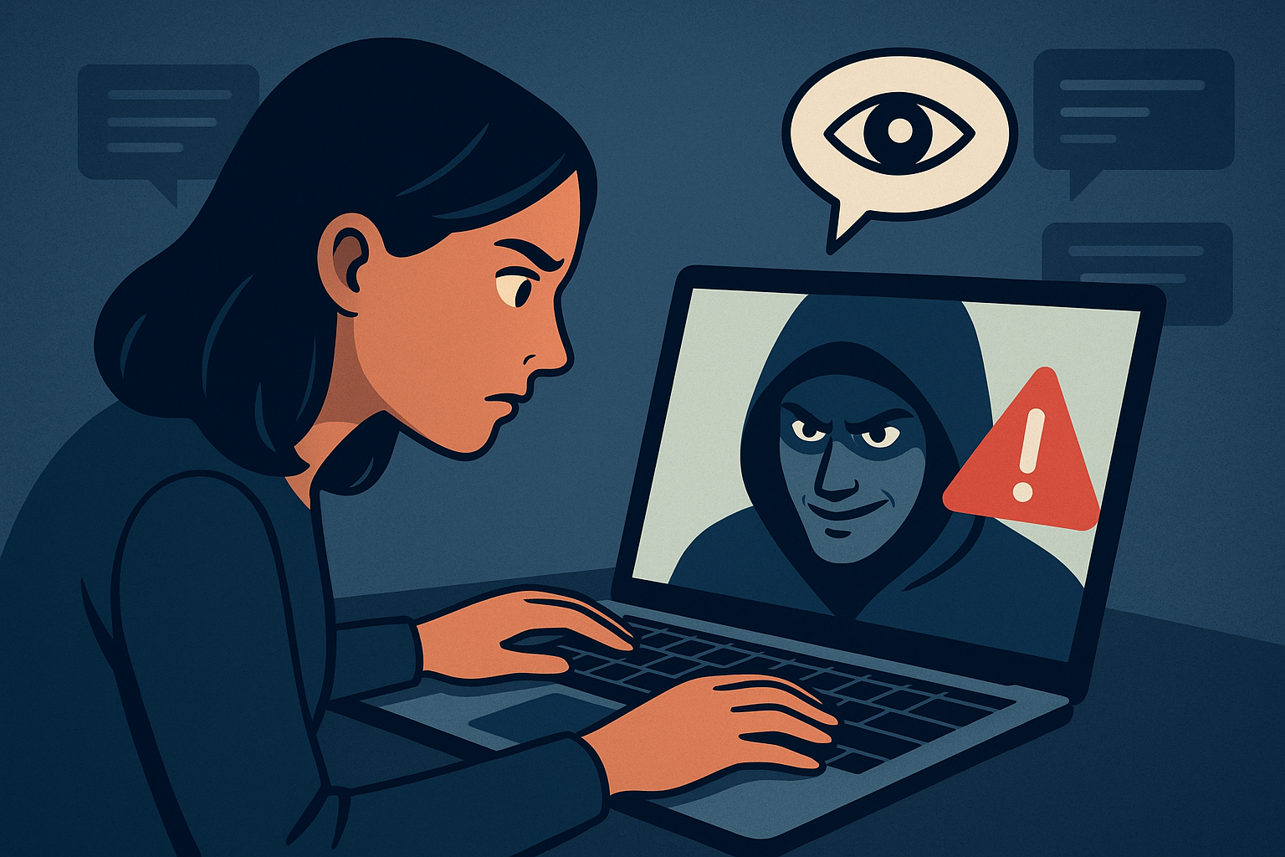
AI Fuels and Expands Gender-Based Violence
Deep fakes and image-based abuse: 98% sexual in nature and 99% affects women.
Amplification of misogynistic content.
New avenues for stalking and surveillance.
Biased risk assessments.
Reinforcement of stereotypes.

Slide 9
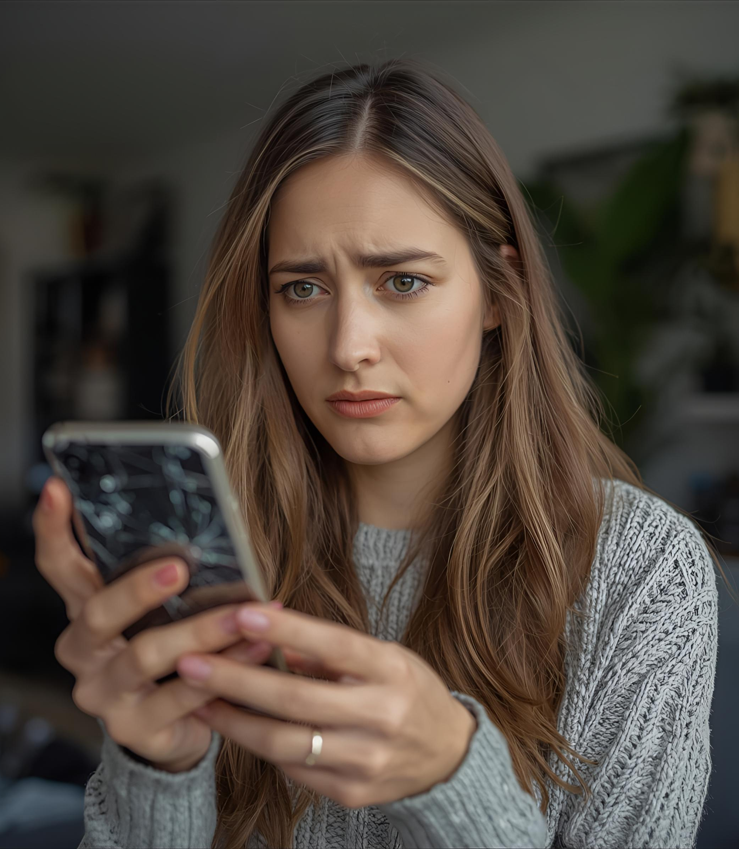
Harm Extends Beyond
Harassment and Violence
Economic insecurity.
Healthcare discrimination.
Mistrust in technology.
Privacy threats.
This is NOT just about technology.
It is about women’s safety,
livelihoods, and voices.

Slide 10
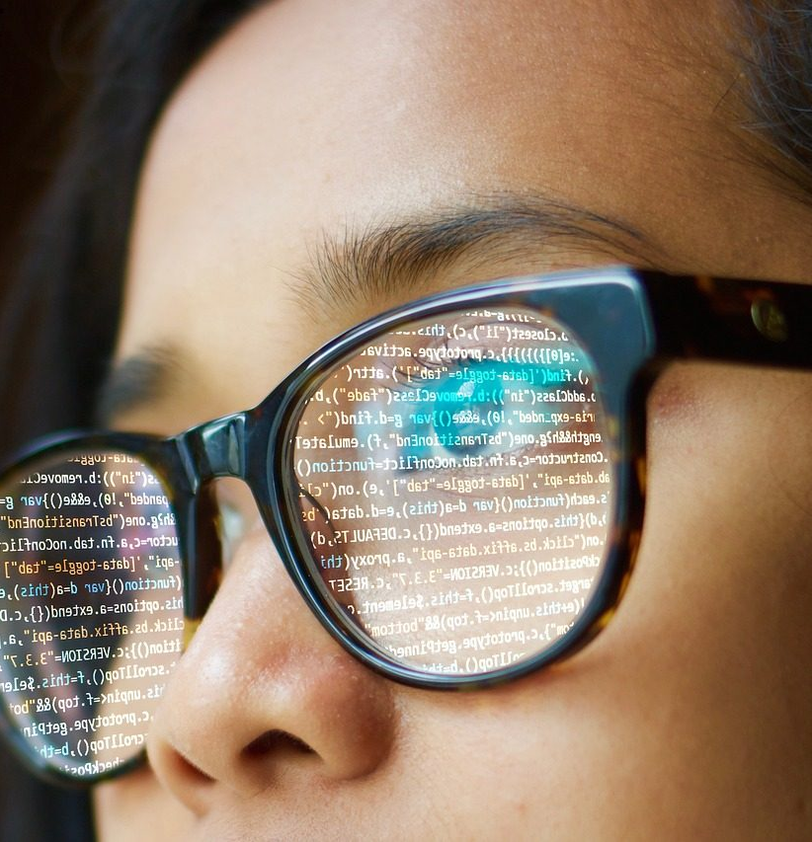
The Other Side of the Story…
Survivor support chatbots - confidential, judgment-free spaces for women to seek help and information.
Abuse detection tools - identify and remove online harassment or non-consensual images.
Policy data analysis - uncover hidden trends in gender-based violence.
Enhanced reporting systems powered by AI -simplify the reporting process, preserve anonymity, and connect survivors to resources.

Slide 11
Promising Examples.
bSafe: Provides safety alerts for women.
Botler.ai: Helps survivors determine violations of criminal law.
Sophia and rAInbow: Provide confidential legal and emotional support.
Laaha: Delivers essential information directly to women and girls.

Slide 12
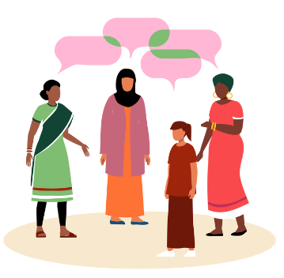
Zonta’s Involvement in Laaha.
Zonta became involved in the program by vote at the Brisbane convention.
“Laha” is an Arabic word meaning “for her” or “belongs to her”.
UNICEF made it a brand by adding an “a” so that it is “Laaha”.
Accessed anywhere from around the world: https://www.laaha.org/en/home.

Slide 13
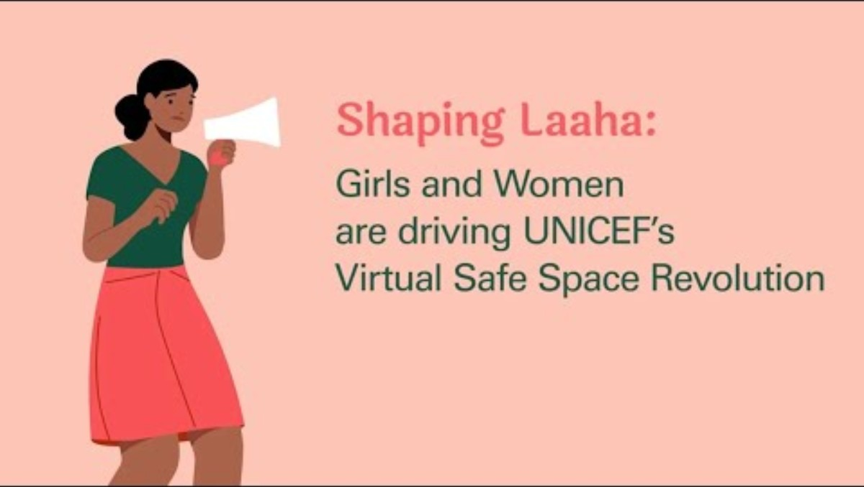
The Impact of Laaha
Over the past 2 years, Laaha has reached 1.5 million girls.
Video: https://www.youtube.com/watch?v=zGM9HKxLsHs

Slide 14
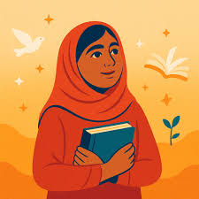
https://www.laaha.org/en/home.

Slide 15

The Path Forward.
Ethical development.
Human-centered design.
Robust regulation and policy.
Ongoing oversight.
Support safe digital places for women and girls.
Image by Roman Budnikov

Slide 16

Thoughts to take home….
Bias in AI is about justice, equality, and safety of women and girls worldwide.
Let’s help shape the future of AI into something that uplifts and empowers, bringing us closer to a truly equitable world.
Spread the word about Laaha.

Slide 17

QUESTIONS?

