Slide 1
Zonta USA Caucus 2018-2024 Ranelle Randles, Advocacy Chair Boulder Foothills Club and D12 USA Caucus Delegate Denise Parrish, D12 Advocacy Chair, Cheyenne Club Advocacy Chair, and Former D12 USA Caucus Delegate (currently Alternate) Sherilyn Gourley, Advocacy Chair North 40
D12 Conference
September 16, 2023
Ft. Collins, CO
Notes:
Who is in the room?
What do folks know about the Caucus? Former members?
Lots of experienced Zontians in the room who can add to the discussion.

Slide 2
Workshop Purpose
Learn more about the work of the USA Caucus and how to individually and collectively amplify our Zonta voices on National issues!
Formation and Purpose of the Caucus
What does the Caucus do?
How can I get involved? Call to Action!
Questions and Discussion throughout
Notes:
Main objective is to increase knowledge about the Caucus, it’s resources and to get more Zontians engaged in national advocacy thru FAF’s.

Slide 3
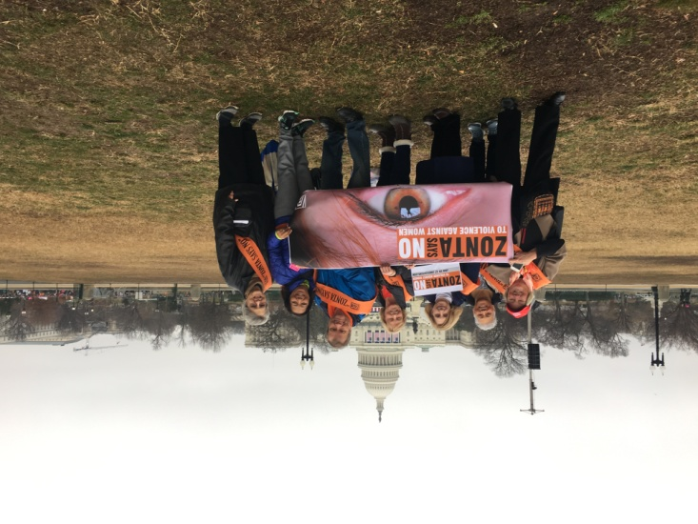
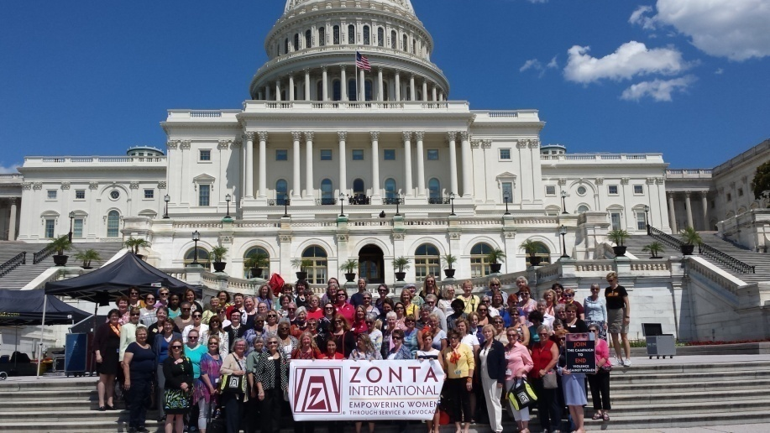
2017 Women’s March; Commission on the Status of Women, N. American Interdistrict Meeting in Virginia Founded by ZI Board Feb 2018; under auspices of ZI Advocacy Committee
Formation 2018
Notes:
2017 Women’s March. The first March was a grassroots movement as women feared women’s rights were at risk. The mission organizers put together a non partisan event and the ZI Board agreed Zontians in the US could march as Zontians.
A few Zontians who attended CSW and the NAIDM later that year talked about how to create a Zonta voice at the national level in the US.
The US Women’s Caucus at the UN was forming and for Zonta to have a voice, we needed a US organization to do so. Bobbee Cardillo and Cheryl Mulhern came up with a recommendation, which was approved by the ZI International Board.
US Women’s Caucus at the UN---US Feminists Collaborating to Advance Human Rights and Gender Equity for Women and Girls Worldwide

Slide 4
Purpose of the USA Caucus
The USA Caucus in a place to align on key issues, and provides a platform for coordinated advocacy actions at both the National and State level
Goals:
Encourage development, consideration and passage of appropriate legislation by the US Congress and by State legislatures
Take action in support of, or in opposition to, proposed or enacted legislation and executive orders and regulations that directly or indirectly impact the lives of women and girls
Promote women’s representation in decision making positions on an equal basis with men
Notes:
The goals here truly represent the original purpose (and today’s primary purpose) of the Caucus. However, it seems that we are starting to expand a bit and have started provided more ideas and information to Clubs that involve more types of advocacy that involved more focus beyond just passing legislation…Perhaps ideas that raise awareness of issues for which there might not yet be legislation (but should be).
The website is a great resource and the Caucus is now sharing a lot more information that Clubs can use in their advocacy efforts. There are educational materials, service projects ideas aligned to our Advocacy efforts, best practices, and sharing so every Club doesn’t have to reinvent the wheel.

Slide 5
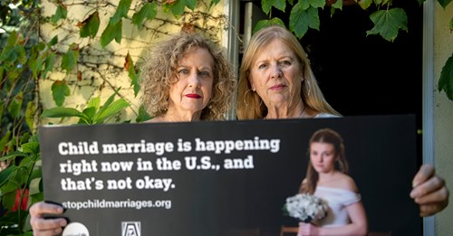
Establishing the Caucus 2018-19
The Caucus Joined:
US Women’s Caucus at UN
ERA (Equal Rights Amendment) Coalition
Coalition on Child Marriage with a Caucus member on the National Steering Committee
Notes:
An early principle was the concept of partnering with other organizations who share our mission or goals.
The US Women’s Caucus at the UN is an alliance of US feminists and non-governmental organizations engaged in joint advocacy at the United Nations Commission on the Status of Women. We research issues, exchange information, and promote the principles of the women’s human rights agenda declared in the UN Convention on the Elimination of All Forms of Discrimination Against Women (CEDAW) and the Beijing Platform for Action. We advocate for greater gender equality at home and abroad with the US government including the White House, Congress, State Department, and US Mission to the UN. Through this collaboration, we all have a larger, louder, stronger voice together by leveraging our collective knowledge and capabilities.
Many Zontians were involved as individuals., and many took leadership roles.

Slide 6
Establishing the Caucus 2018-19
Established website: www.zontausa.org
Created USA Advocacy Action Center
Committees Established
Convenors Appointed
Branding: Logo and screen backgrounds
Notes:
Branding
Get people to use website! It is a great Advocacy Resource

Slide 7
How Does the USA Caucus Operate?
Under auspices of ZI Advocacy Committee, non-voting Convener leads Caucus (currently Bobbee Cardillo)
13 Governors with US clubs appoint a Delegate and Alternate to represent them
Governors “Always welcome; never expected”
Meet Monthly
Work done by Caucus Committees and through Coalitions the Caucus has voted to join
Every Delegate and Alternate must participate in one committee
1 Vote per District (Delegate consults with Governor as decision maker:
Business decisions—Majority
Public-facing Statements, Testimony, etc-- 100%

Slide 8
Political vs. Partisan
Non- partisan means Zonta can’t be advocating for a candidate or a party. However, we can advocate for a position or a policy.
Advocacy is by its nature political
Video on Political versus Partisan (YouTube)
https://zontausa.org/advocacy-political-yes-non-partisan-yes/
This short video illustrates the difference between partisan and political. Zonta does not advocate for a candidate for a party, but we can and do advocate for a position or a policy.
Notes:
Can we download video?
Sherilyn to lead

Slide 9
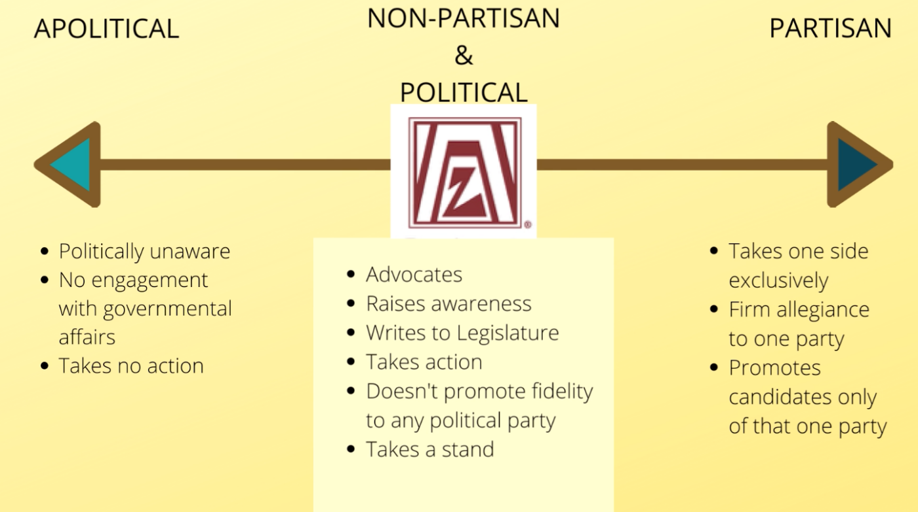

Slide 10
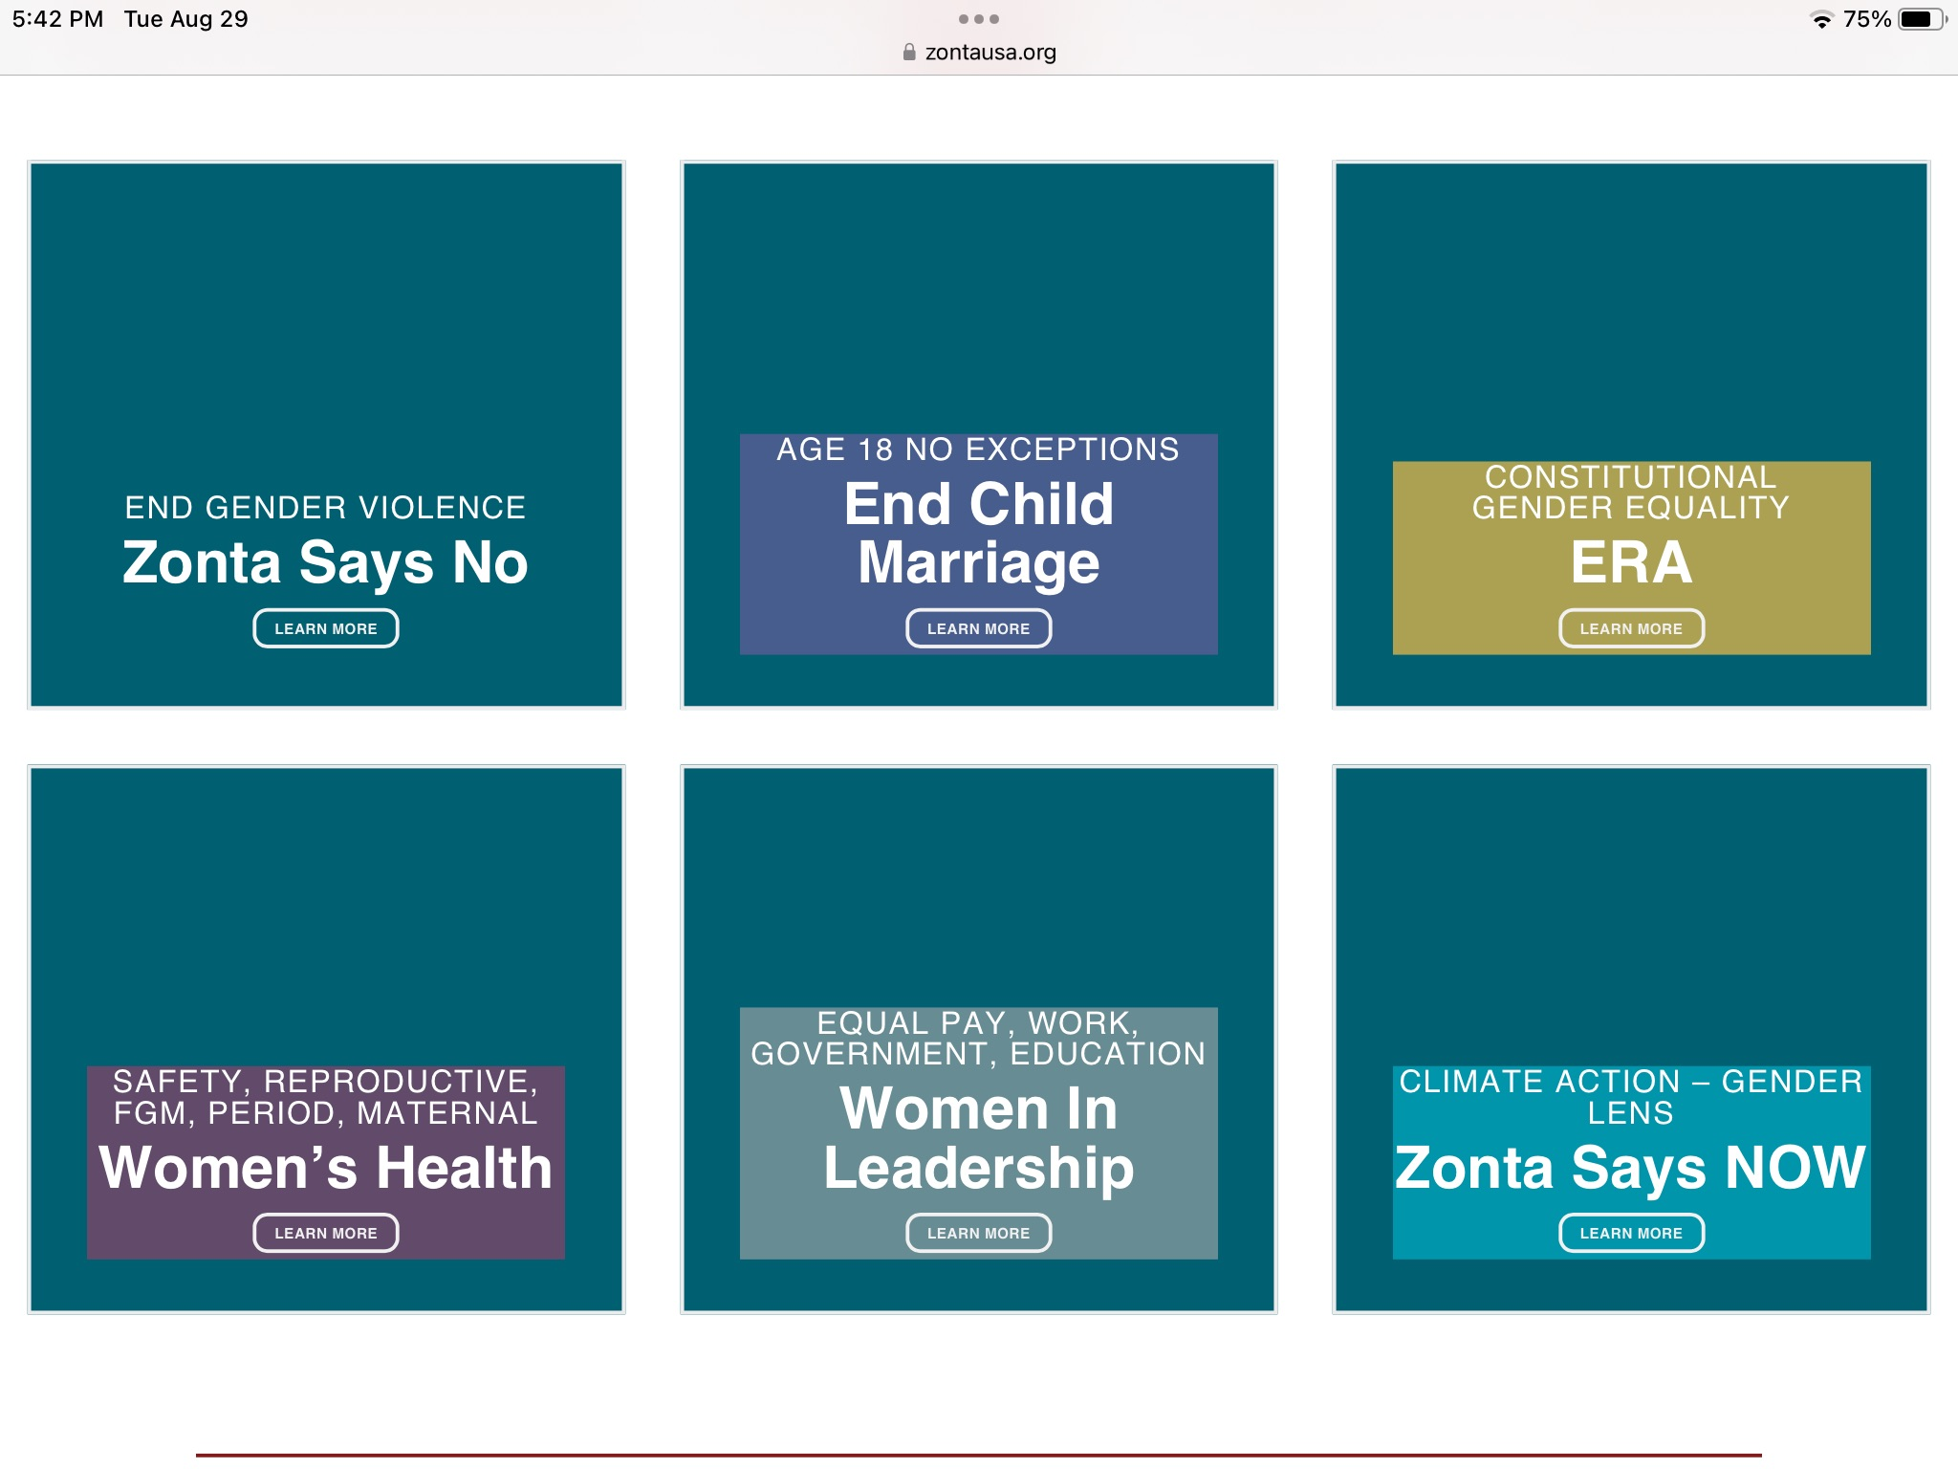
Notes:
These are the current Committees
Non-Caucus members are welcome to join Committees!

Slide 11
Accomplishments
Child Marriage Billboard and Awareness Campaign
Led successful actions in MA & MI and started Coalition in CA
Billboards today in Lansing MI
Joined Amicus Brief supporting the ERA
Hosted a call with Board Member Renee Coppock and Caucus members, Governors, Zonta Says NOW climate champions on a MT lawsuit suing the state for failure to provide a clean and healthful environment
Zonta Says NOW USA Think Tanks
Service, Advocacy Project ideas on website; as well as templates of social media posts
Created Political, Not Partisan Video
Created bi-monthly Advocacy Bulletin

Slide 12
Accomplishments
Zonta USA Facebook page posted daily memes during 16 Days of Activism
Clubs and Caucus members supported passage of “18-No Exceptions laws” several states
Via “Chain-In” speeches, Speaking at state hearings and directly with legislators, billboards
Period Poverty Toolkit added to website
Created ad hoc committees
Rules of Procedure, Delegate job description
Zonta represented in new Smithsonian American Women’s History Museum
Updated “how to talk to your legislator” on website
Issued Statement on Women’s Equal Pay Day March 14 and other dates that mark Asian American, Latina, Native Women and Black Women’s Equal Pay Day

Slide 13
Accomplishments
Created Service and Advocacy Project idea sheets on DV, Human Trafficking, Sexual Assault for website
Joined National Committee on Pay Equity
Sent FAFs on 10 bills and urged confirmation of the At-Large Ambassador for Women’s Affairs
Attended hearing of Senate Judiciary Committee on ratification of the ERA
Submitted written testimony in support of SJ Res 4 for the record
Signed onto a letter as a supporting NGO from Congress to the President on ratification of CEDAW
Zonta Says NOW USA Think Tank Sessions

Slide 14
Fast Action Friday Alerts Call to Action
Why important: Membership
Competing US NGOs use quick action buttons for advocacy: AAUW, Planned Parenthood, LWV, National Fed Bus and Prof Women, Unicef USA
Impact since January 2022
55 bills supported
20,000 emails sent to officials
335 Zontians taking personal action bi-weekly
Legislation Passes
Members feel empowered to Make a Better World for Women and Girls!
Notes:
Call to Action! Huge opportunity—we have 8000 members in the USA. Think about the impact we could have if all Zontians were engaged in Fast Action Friday to amplify our collective voices.
Non-Zontians can also participate

Slide 15
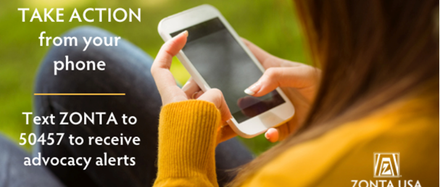
Easiest Way? – On your phone!!
Sign up via phone or email!
Two clicks and you can have your voice heard!
Text “Zonta” to number: 50457
Notes:
Let’s consider short breakout groups to get ideas on how we can get all Zontians in the US to take action!
And have people review the website. Take them through the various resources.

Slide 16
https://zontausa.org/about-zonta/usa-caucus/
Recent FAF’s
Address maternal health disparities and prevent maternal deaths
Provide job protections for survivors of domestic violence, sexual assault and stalking
Increase support for survivors of human trafficking
Resources
Project Sheets : Violence Against Women, others
Ending Period Poverty Toolkit
Statements
Social Media Posts
Articles
Notes:
Resources galore

Slide 17
Table Discussion
Any General Feedback on the Caucus, it’s role and activities
How can we get Club members engaged in FAF’s?
Are the website and the resources useful? Suggestions?
Anything else?

