Slide 1
Advocacy Update
Presented by Denise Parrish, District 12 Advocacy Chair
District 12 Conference – Colorado Springs, Colorado
September 26, 2021 (Updated)

Slide 2
Zonta USA Advocacy Caucus

Slide 3
Zonta USA Advocacy Caucus
Caucus’s Goal
Encourage development, consideration, and passage of appropriate legislation by Congress and state legislatures
Take action in support of, or in opposition to, proposed or enacted legislation, executive orders, and regulations that impact the lives of women and girls
Promote women’s representation in decision-making positions on an equal basis with men.
It is a place for Clubs and Districts in the USA to align on key issues, and to provide a platform for coordinated advocacy action in the USA
Zontausa.org

Slide 4
Zonta USA Advocacy Caucus
Members
Each District Governor with clubs in the USA appoints a representative to the Caucus who participates and votes on behalf of their district
D12 representative is Denise Parrish (Advocacy Chair) with Alternate of Ranelle Randles (previously Elizabeth Freedman)
Voting (especially on issue positions / statements to be issued)
Currently, all districts must agree - voting is through or in consultation with the District Governor
Discussion about changing the voting to a super-majority instead of unanimous – Created an Ad Hoc Subcommittee to review Rules of Procedure
A member of the Zonta International staff attends the meetings – helps assure that the positions of the caucus don’t get ahead of (or are inconsistent with) those of ZI

Slide 5
Zonta USA Advocacy Caucus
Current Subcommittees / Task Forces (as of end of September, 2021)
Equal Rights Amendment
Child Marriage
Ending Violence Against Women (also address Title IX sexual assault on campuses)
Health
Women at Work (also to address issues related to Student Debt and Repayment Rules)
Climate Change
Specific Subject Matter Think Tanks
Subcommittees and Task Forces are subject to change especially with the start of each biennium.

Slide 6
Zonta USA Advocacy Caucus
Recent Statements on Current Events
January 6th Violence at the Capitol
Concern about Women and Girls in Afghanistan
Texas Law SB8
Video on Political versus Partisan (YouTube)
https://zontausa.org/advocacy-political-yes-non-partisan-yes/
This short video illustrates the difference between partisan and political. Zonta does not advocate for a candidate for a party but we can (and do_ advocate for a position or a policy.
PLEASE SHARE THIS VIDEO WITH YOUR CLUBS.

Slide 7
January 6th Violence at the Capitol
The Zonta USA Caucus, part of Zonta International, a leading democratic and global non-profit founded in the United States over 100 years ago to empower women, decries the forced entry into the US Capitol that occurred on January 6, 2021.
This violent assault on our national symbol of democracy goes against the Zonta ideal of promoting the rule of law and following peaceful and democratic processes.
The Zonta USA Caucus strongly condemns the illegal actions of any group that physically menaces and harms our elected representatives, our national Capitol, and indeed the institution of democracy itself.
Such criminal acts must not be tolerated. We call on our elected officials to take immediate action against those responsible to deter such actions in the future and thereby ensure the safety and respect for those who honor the democratic ideals of our nation.

Slide 9
Texas Law SB8
On August 31, 2021, the U.S. Supreme Court failed to prevent the implementation of Texas law SB8, which not only prevents women from seeking abortions after six weeks of pregnancy but incentivizes private citizens to sue abortion providers or anyone aiding a person in obtaining such an abortion. In addition to harming women’s rights to bodily autonomy, this law circumvents normal legal practice and eliminates the accountability of states to follow federal law.
The Zonta USA Caucus asserts that reproductive rights are human rights and a prerequisite for poverty eradication and for positive sustainable development. The Caucus reiterates that every person should have the freedom to make decisions about their bodies and to safely and privately access healthcare. The Texas law is unacceptable, as it disrespects women’s ability to make choices and sets a dangerous precedent in turning citizens against one another by delegating enforcement to private individuals.
Members of the Zonta USA Caucus will use every avenue available to advocate for and to uphold full and equal rights in the United States in keeping with Zonta International’s objects, which include promoting justice and universal respect for human rights and fundamental freedoms.

Slide 10
Zonta Advocacy Action Center and Fast Action Friday

Slide 11
Zonta USA Advocacy Action Center
Zonta International has created a brief video about the Action Center and the opportunities it provides to people looking to take action for women and girls.
https://www.dropbox.com/s/hl9tnyisxaa2tp1/USA%20Advocacy%20Promo%20Video.mp4?dl=0
or
https://www.youtube.com/watch?v=xpdaHcoJmCs
Link to the USA Advocacy Action Center
https://www.votervoice.net/Zonta/home

Slide 12
Zonta Fast Action Friday
Zonta International has created a brief video about Fast Action Fridays and how to take action through the site.
https://www.dropbox.com/s/8iawvyjlu1c79lw/USA%20Advocacy%20Tutorial%20Video%20%281%29.mp4?dl=0
or
https://www.youtube.com/watch?v=6YqdX3NBSPM
Link to the USA Advocacy Action Center
https://www.votervoice.net/Zonta/home

Slide 13
Recommended District 12 Advocacy Project
RESPECT WOMEN
Ending Violence by Breaking the Cycle

Slide 14
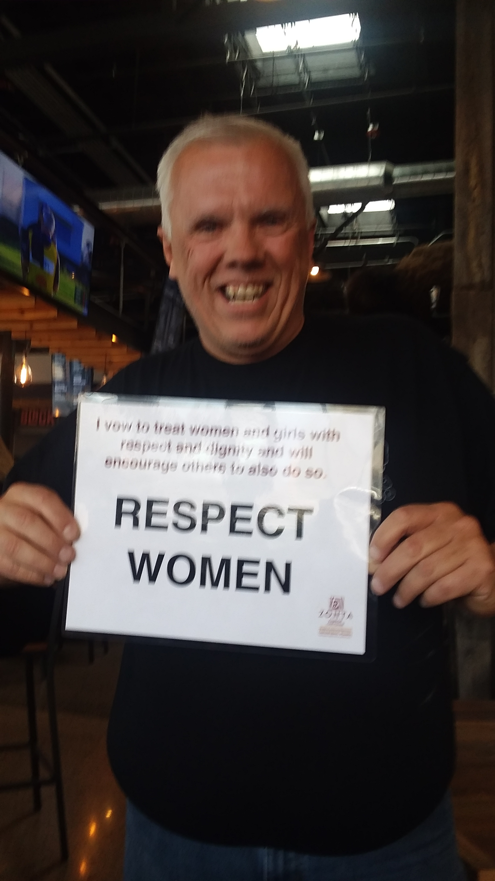
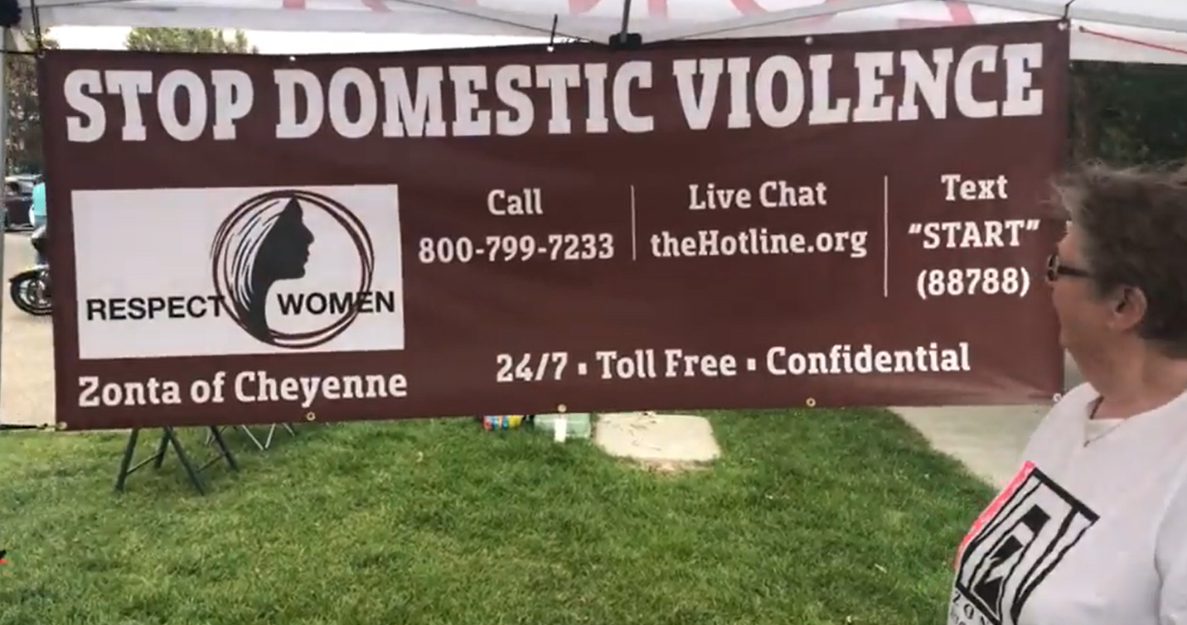
Recommended District 12 Advocacy Project

Slide 15
Taken from Violence Against Women: Let’s Stop It at the Start (Australian Initiative)
Recognizing Disrespect and Aggression In Youth
Laughing at others and putting them down
Bullying, teasing, and calling them names
Fighting on playground / rough behavior on sports field
Intimidation / Public Harassment
Sharing photos / Giving out personal data on-line
Violence against women and girls starts with disrespect. The excuses we make adults allow disrespect to grow.

Slide 16
Taken from the #Callitout Toolkit (published by Victoria State Government)
What Should Be Called Out?
Sexually suggestive or sex comments/jokes
Leering / Staring
Cat-calling / Wolf-whistling
Sharing inappropriate images
Comments about a person’s suitability for a role based on gender
Belittling women
Stereotypes about skills
How to Respond?
Don’t laugh
Disapproving look
Pointed / Uncomfortable Silence
Comment / Disagree with Explanation
Stand up for the Person Affected

Slide 17
Selective Suggestions of Actions (Taken from Zonta 16 Days Toolkit)
Invite men and boys to join you in your actions
Put together a photo campaign of men and boys in your community with Zonta Says NO (or Respect Women) signs - share via social media
Raise awareness of gender-based violence via social media, chalk art, yard signs, billboards, or other public display
Interview local Police Chief or Government Official and publish on website / share on social media
Organize a march / virtual march (which might be a montage of pictures of various individuals with signs or silhouettes)

Slide 18
Offer: Further Discussions

Slide 19
If you would like further discussions….
Please feel free to contact me if you would like me to participate in one of your meetings either electronically or in-person
Please fee free to email me or contact me anytime
parrishzonta@gmail.com
(307) 286-1463 (cell)
(307) 632-5606 (landline)
I’d be happy to try to
Answer questions
Suggest projects
Update you on Zonta issues

