Slide 2
Managing Change: Surviving and Thriving in the Midst of Chaos
Judy Barth, Zonta Club of Fort Collins

Slide 3
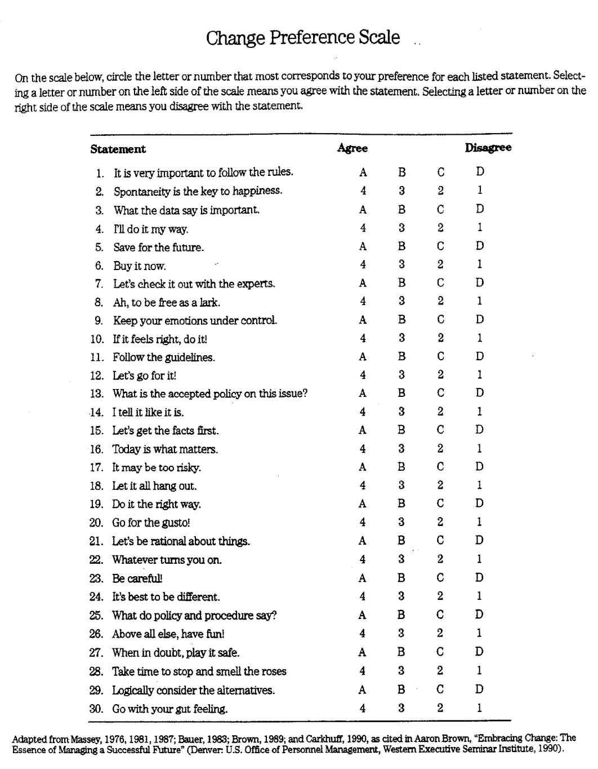

Slide 4
The Change Preference Scale - Sample

Slide 5
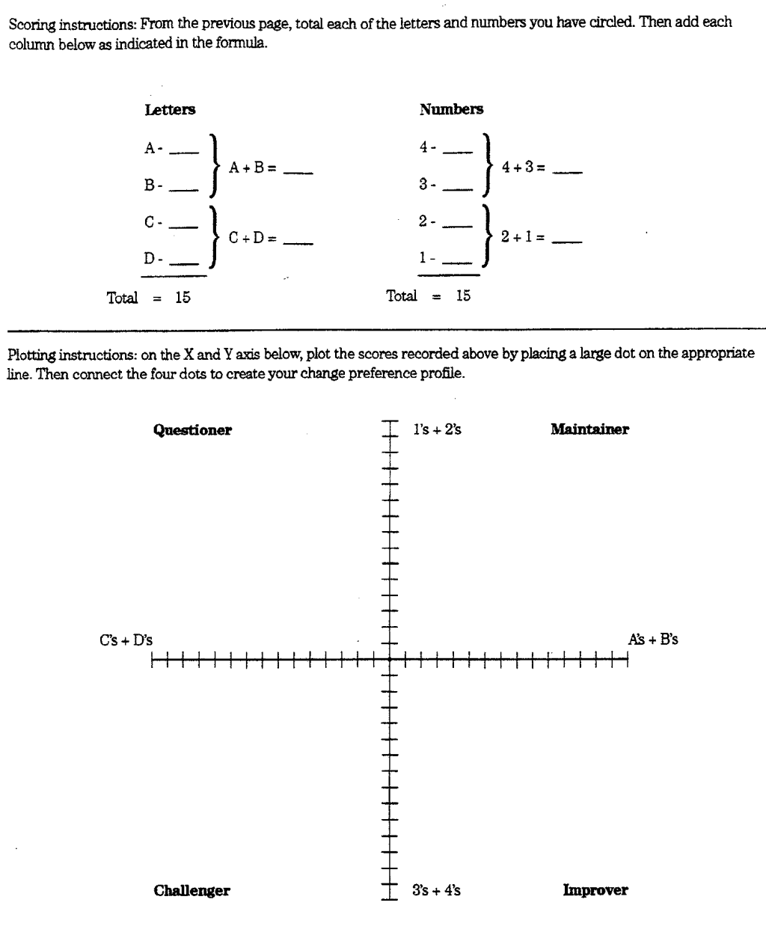
Scoring the Change Preference Scale

Slide 6
Sample Results

Slide 7
What the Preferences Mean
Questioner Likes new systems/ technical things/gadgets Wants intense experiences Seeks knowledgeable authorities Tends to be conservative/skeptical Respects directness Accepts change if systematic | Maintainer Likes things as they are Values hard work, task oriented Respects authority Security and rules & procedures oriented Facts/data are important Objective
Challenger Likes new things Feeling and idea oriented Values Independence Expects participation Questions rules and procedures Seeks change Flexible | Improver Likes different things Task and feeling oriented Enthusiastic, energetic Assertive Wants to improve things Trouble shooter Can see both sides of an issue

Slide 8
How the preferences impact what you need when considering the change
Questioner needs: Knowledge from an authority figure To hear directly To hear how the change is new and creative To learn how the change will be implemented, step by step | Maintainer needs: Facts from an authority figure Rules and regulations Objective approach Concrete examples of how to proceed
Challenger needs: Participation in the process To know how the change will impact them To independently learn and decide about the change | Improver needs: To know how the change will improve things Interaction with others about the change To evaluate both sides of the change, before and after Direct communication about the change

Slide 9
References
Meeting Change in the 21st Century: A Self-Instructional Approach, Louise F. Cyr and Judith B. Meier, Extension Service – U.S. Department of Agriculture and Extension Committee on Policy, Washington, D.C.
Embracing Change: The Essence of Managing a Successful Future, Aaron Brown, Western Executive Seminar Center, Office of Personal Management, Denver, CO.
Managing Change During These Uncertain Times, Angela Hayes, CSU Career Center, April 22, 2020.

