Slide 1
Join Zonta!

Slide 2
EMPOWER HER
GIVE HER A CHANCE

Slide 3
3
Zonta’s Mission
A leading global organization of professionals
empowering women worldwide through service and advocacy

Slide 4
4
Zonta’s Vision
Gender Equality
Women’s rights are recognized as human rights
Empowerment
Every woman is able to achieve her full potential
Access to all resources
Women have access to all resources and are represented in decision making positions on an equal basis with men
A life free of violence
No woman lives in fear of violence

Slide 5
5
Guiding Principles
Women’s rights are human rights, essential for the development of all peoples.
Zonta International endorses the values expressed in the United Nations Universal Declaration of Human Rights.
Member Values
Conviction, Commitment, Courage!

Slide 6
Envision Equality - Empower Women
IMPACT
locally &
globally
MAKE
lasting
change
Member
Partner
Supporter
Ally
Empowering
Women
Be
DEVELOPED
as leaders
INVEST
in the future
Notes:
And a supporting message: “together we are stronger”.

Slide 7
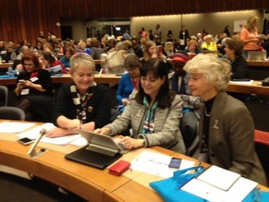
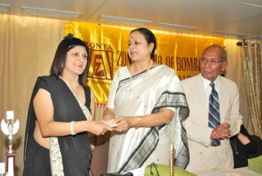
thru
Advocacy
Service
Education
Zonta Says NO! to Violence against Women
MAKE
lasting
change
Notes:
And a supporting message: “together we are stronger”.

Slide 8
More than 30,000 Members
More than 1100 Clubs
Nearly 70 Countries
Founded in 1919
Thousands of Local Service Projects
General Consultative Status with the UN
IMPACT
locally &
globally
Notes:
And a supporting message: “together we are stronger”.

Slide 9
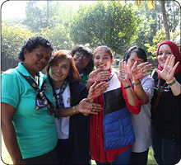
$5 million each 2 years for International Service Projects
$10 million cumulative for ZI Strategies against Violence against Women (ZISVAW)
$100,000’s in Scholarships annually
Thousands of Service Projects around the world by clubs and districts
Zonta Says NO! to Violence against Women
Empowering thousands of Women and Girls through Legislation, Advocacy and Service
INVEST
in the
future
Notes:
And a supporting message: “together we are stronger”.

Slide 10
Develop oneself while developing others
Mentoring - Locally, Nationally and Globally
Leadership Training
Board training
Advocacy training
Networking – 30,000 members in 67 countries
Friendship and Fun
Be
DEVELOPED
as leaders
Notes:
And a supporting message: “together we are stronger”.

Slide 11
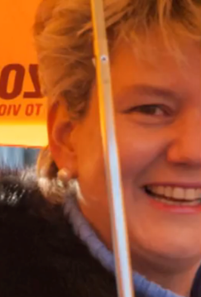
Women and Men with a Common Purpose
Empowering Women – thru SERVICE AND ADVOCACY
Participate
Advocate
Achieve
Together we are stronger!
Notes:
Participate in service projects that help women achieve their potential
Advocate on behalf of women’s issues locally and internationally
Achieve greater impact internationally by combining our voices with like-minded organizations and the United Nations
Work with government and community leaders who share common goals

Slide 12
IMPACT
locally &
globally
MAKE
lasting
change
Empowering
Women
Be
DEVELOPED
as leaders
INVEST
in the future
JOIN US ! – www.zonta.org
Notes:
And a supporting message: “together we are stronger”.

Slide 13
BACK UP AFTER THIS SLIDE

Slide 14
14
Advocacy - Global
Zonta possesses
General Consultative Status at
Participative Status at
Membership at
The Conference of NGOs
Consultative Relationship to ECOSOC
Operational relations with

Slide 15
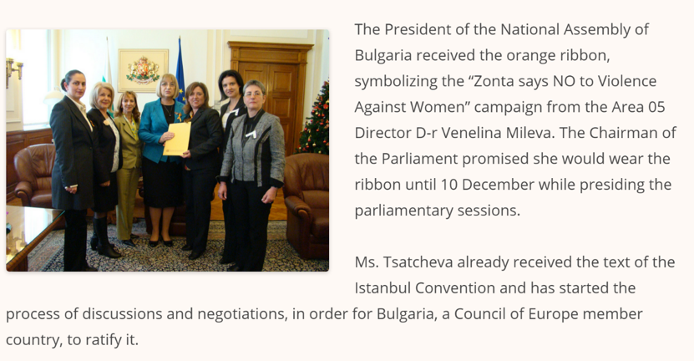
15
Advocacy - Local
Members also perform local advocacy in their communities

Slide 16
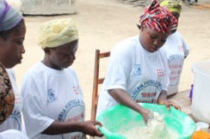
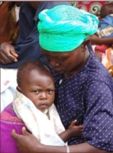
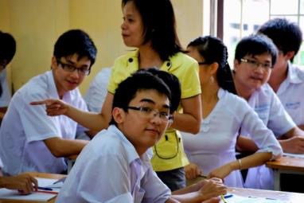
16
Zonta’s International Service Programs
Eliminating Obstetric Fistula in Liberia
Towards an HIV-Free Generation in Rwanda
Gender Responsive Schools in Vietnam

Slide 17
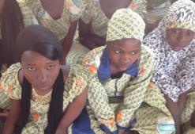
17
ZISVAW*
Delaying Early Marriage in Niger
Voices Against Violence in 12 countries (Japan, Korea, Philippines, Democratic Republic of Congo, Burkina Faso, Rwanda, Nigeria, Malawi, Zambia, India, USA, and Brazil)
*Zonta International Strategies to End Violence Against Women

Slide 18
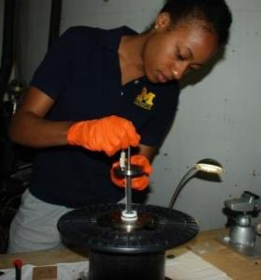
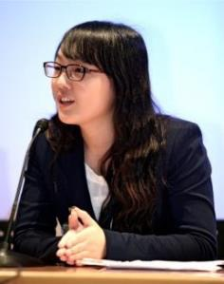
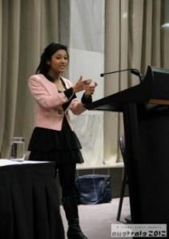
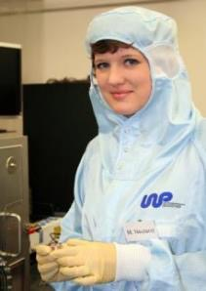
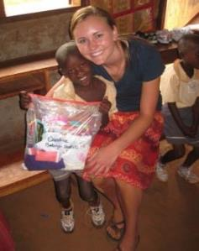
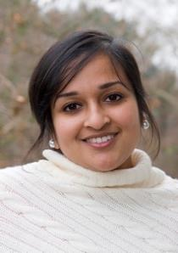
18
Educational Programs and Awards
Amelia Earhart Fellowship – Full time PhD/Doctoral candidates in aerospace-related sciences or engineering.
Jane M. Klausman Women in Business Scholarship Women studying business, demonstrating outstanding potential.
Young Women in Public Affairs Award Women ages 16-19 involved in volunteer leadership, government, and empowering women
Z- and Golden Z clubs Student Organizations at High School and College Level working to empower women
www.Zonta.org/Scholarships
Notes:
More Than 10 Million US Dollars Awarded
Amelia Earhart Fellowship
35 $10,000 fellowships annually
Jane M Klausman Women In Business
12 $7,000 International Recipients annually
32 $1,000 Regional/District Recipients annually
YWPA – Young Women in Public Affairs
10 $4,000 International Recipients annually
32 $1,000 Regional/District Recipients annually
more at www.zonta.org/scholarships

