Slide 1
Bylaws & Voting District 12 Training June 16th & 20th, 2016

Slide 2
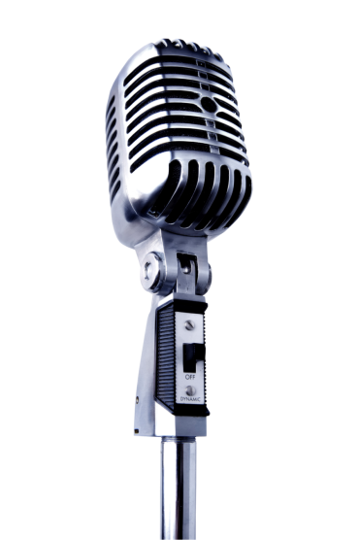
MICROPHONES
PROCEDURAL
Point of Order – for violations of procedure
Point of Parliamentary Inquiry – to check on correct procedure
Request for Information –to ask a question on the pending motion
Recess - to move a recess immediately
Previous Question – to end the debate and to vote on the motion without further discussion.
CON
To make an amendment to a motion.
To speak against a motion or an amendment.
PRO
To make a main motion
To speak in favor of a motion

Slide 3
PROCESS
Main Motion on the screen
Amendment to the motion on the screen
Discussion
Discussion
Vote
2/3 YES
Less than 2/3 YES
Majority No
Vote
Majority Yes
Motion carries
Motion fails
The amended motion on the screen
Discussion
Vote
Less than 2/3 YES
2/3 YES
The amended motion carries
The amended motion fails

Slide 4
MOTION FORMS - BYLAWS
Each Governor will receive a packet with motion forms in the room of their District meeting.
Forms on triplicate paper
White to President
Yellow to recorder
Pink for maker of motion
Additional motion forms will be with monitors, who will be sited by the microphones.

Slide 5
PRESENTING MOTIONS
Go to the PRO microphone with three copies of the motion.
First copy for the monitor, second copy for the Board assistant and the third copy for you.
When it is your turn to speak, start as follows:
The motion has been given to the President in writing in advance.
My name is _____. I am delegate for the Zonta club of _________
OR
I am Governor of District ___
OR
I am Member of the Board
OR
I am a PIP
I move that ____________________
PRO

Slide 6
PRESENTING AMENDMENTS
Go to the CON microphone with three copies of the amendment.
First copy for the monitor, second copy for the Board assistant and the third copy for you.
When it is your turn to speak, start as follows:
My name is _____. I am delegate for the Zonta club of _________
OR
I am Governor of District ___
OR
I am Member of the Board
OR
I am a PIP
I move to amend the motion by ____________________
CON

Slide 7
SPEAKING FOR MOTIONS/AMENDMENTS
Go to the PRO microphone.
When it is your turn to speak, start as follows:
My name is _____. I am delegate for the Zonta club of _________
OR
I am Governor of District ___
OR
I am Member of the Board
OR
I am a PIP
I speak for this motion/amendment because ________________
PRO

Slide 8
SPEAKING AGAINST MOTIONS/AMENDMENTS
Go to the CON microphone.
When it is your turn to speak, start as follows:
My name is _____. I am delegate for the Zonta club of _________
OR
I am Governor of District ___
OR
I am Member of the Board
OR
I am a PIP
I speak against the motion/amendment because _____________
CON

Slide 9
AMENDMENTS – 2 steps – new rules
MOVE THE AMENDMENT FROM THE CON MICROPHONE
CON
2. SPEAK FOR THE AMENDMENT FROM THE SAME CON MICROPHONE (Old rules: SPEAK FOR THE AMENDMENT FROM THE PRO MICROPHONE

Slide 10
NUMBER OF VOTES NEEDED
Main motions require 2/3 votes in the affirmative to be adopted.
Amendments require majority to be adopted.
Resolutions require majority to be adopted.

Slide 11
Bylaws & Candidate Slate Review
Review of proposed bylaw changes
Review of candidate slate
Reminder: as discussed in the logistics training
Delegates check in only once at beginning of convention (unless needing alternate to replace her).
Voting
One voting machine given to each delegate – don’t lose it
1 card to insert for each vote
Important matters should be discussed at club meetings, but convention is time to discuss & learn new information. Delegates get the final vote based upon what they learn at the convention
Clubs can advise the club carrying their proxy how they wish them to vote, but legally and technically, cannot tell the delegate how to vote

Slide 12
Campaigning Policy
Zonta International Website for FULL POLICY
http://www.zonta.org/Portals/0/Membership/Policies/Campaigning%20Policy_Nov%202014.pdf?ver=2016-02-19-110109-833
Purpose of policy: Ensure all candidates have the opportunity to inform members in a fair, equitable, and appropriate way.
Campaigning is NOT allowed.
Campaigning is defined as “encouraging” voters to vote for or “discouraging” voters from voting for a specific candidate.
Zontians who are attending an international convention may confer with other members from their own district to discuss the candidates, but they may not instruct the delegates how to vote.
If asked Zontians may orally provide factual information to other Zontians about candidates, but may not by any means solicit votes for any candidate.

