Slide 1
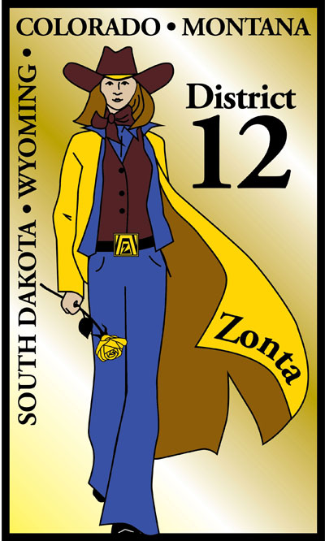
D12 Advocacy and Service 2013

Slide 2
Zonta International Primary Mission
Advance the Status of Women through
Service
and
Advocacy

Slide 3
Advocacy
Advocacy means standing up for a cause.
The District Advocacy Committee can help your club with ideas, implementation, and encouragement .
The Advocacy link on the D12 website has lots on information.
Jane Page is the D12 Advocacy Chair.

Slide 4
D12 Advocacy Award
D12 gives a District Advocacy Award at the District Conference each year.
The award is selected from information clubs put in their annual report to the Governor which is due on May 20, 2013.

Slide 5
Zonta Says No will increase visibility and credibility.
Zonta has had VAW in its sights for a long time.
1999 UN designated November 25 as International Day for the elimination of VAW
1999 ZI created ZI Strategies to End VAW (ZISVAW) and started its first projects

Slide 6
Zonta Says No Has 2 Phases
Each club is asked to participate in a project to raise awareness of VAW and to publicize the effort.
On November 25, 2013 every club and district around the world will stage a public/media event to draw attention to VAW and to report on the number of victims in their community.

Slide 7
VAW Projects
1. What does VAW look like in your community?
2. How do you change the root causes?
Using:
Discussions
Films
Meetings with experts
Activities

Slide 8
Let’s Get Started
The project needs to be visible in the community.
The project can be in partnership with another organization.
Ideas:
Good films on VAW are available.
Most communities have a women’s safe shelter.
There may be VAW legislation pending in your state.
Wear orange on the 25th of each month in support of UNiTE
Other?

Slide 9
Just Say No at the 2013 D12 Conference
A Saturday afternoon session will be devoted to Just Say No.
Attendees at the Saturday night banquet are invited to were orange or orange accents to honor the VAW effort.

Slide 10
Some Current VAW Work
Workshops at the North American Inter-District Meeting in Niagara Falls, Canada,
June 14-16,2013
Advocacy 101 “Finding Your Voice and Helping Others Find Theirs”
Advocacy 301 “Capacity Building”
Zonta is working with over 100 other organizations on a strategy to get CEDAW passed in the USA.

Slide 11
Service
District 12 clubs have a history of great service projects.
Denver II created a community room at a women’s center.
Southern Black Hills gave donated career wear to women and girls in transition.
Pikes Peak Area mentored a female non-traditional student at UCCS.
Converse County gave welcome baskets to new residents of Jubilee House for women parolees.

Slide 12
D12 Service Award
D12 gives a District Service Award at the District Conference each year.
The award is selected from information clubs put in their annual report to the Governor due May 20, 2013.

Slide 13
NEW: ZI Service Recognition Award
Zonta International has established the Service Recognition Award to recognize outstanding service projects benefiting women in the local community.
This award
honors clubs and districts
provides an exchange of excellent models of service
increases Zonta’s visibility and credibility

Slide 14
SRA Details
SRA’s will be given to 6 clubs and 3 districts at the 2014 Convention in Orlando.
Two categories of projects will be considered:
Projects that improve the status of women in general
Projects that prevent and fight VAW. These could support the Zonta Says No campaign.

Slide 15
More SRA Details
Projects can be sponsored by clubs or districts.
Club Awards: A club can nominate 2 projects – one from each category using the nomination form. Nominations must be received by the District Service Chair by December 30,2013.
District Awards: A district can nominate 1 district sponsored project implemented by clubs within the district. It can be in either category. Submission deadline is February 10,2014.

Slide 16
District Evaluation
The D12 Evaluating Committee will select 3 club projects – at least one must be VAW – and submit these to ZI.
All project submitted to ZI will be exhibited during the International Convention in Orlando.

Slide 17
D12 Service Committee
The D12 Service Committee will send details including nomination forms to club Service Chairs and will support them throughout the process.
The D12 Service Committee will organize implementation of the D12 Service project.

Slide 18
D12 Service Project
At a club business meeting in October or November each club will collect items needed by a local women’s shelter. These items will be given to the shelter with as much publicity as can be created.
Every D12 club is encouraged to participate. This is a D12 wide project.
Comments/Questions?

