Slide 1
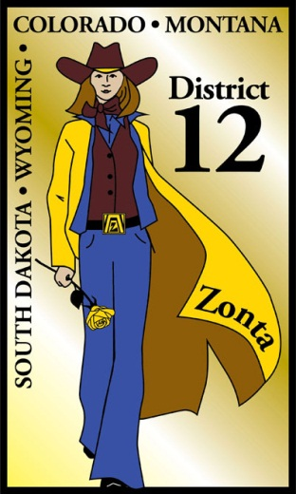


Is there a Hole in your Bucket?
The Importance of Recruitment AND Retention
Michelle Ammerman, District 12, Area 2 Vice Area Director

Slide 2
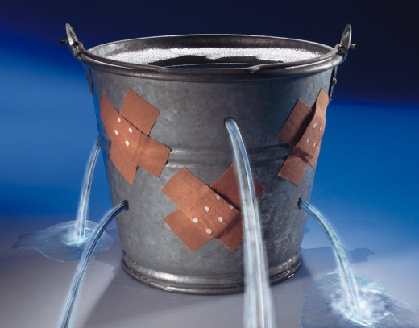
Hole in the Bucket – Add 1, Lose 2
Like most organizations, clubs and fraternal organizations, a great deal of focus is on recruitment of new members
A common challenge among clubs and organizations of all types and sizes is not only recruiting new members, but retaining those members, and perhaps more importantly, retention of long term members.
We all know that recruitment is critical, but retention is our lifeblood.

Slide 3
What is the reality?
It is cheaper to retain a member than to recruit a new member.
FACT:
When a member is lost, two must be recruited to grow
When a member is retained, new growth occurs with every new recruit

Slide 4
Are We Disposable?
With competition from other obligations and activities increasing, disposable income and leisure time at a premium and other challenges, it’s important that you consider the needs of your current membership.
We all need to remember – We NEED our members… Do our members need us?

Slide 5

Strategy
Every club should have a marketing strategy, and important element of your club’s marketing strategy should be thinking of ways in which you can retain your existing members.
Develop a Recruitment and Retention Plan. A failure to Plan is a Plan to Fail. Plan your Recruitment and Retention Strategy. Work your Recruitment and Retention Strategy. – PLAN YOUR WORK. WORK YOUR PLAN.

Slide 6

New Member Action Steps
REFER
INFORM
INVITE
INSTALL
ORIENT
EDUCATE
INVOLVE

Slide 7
Involve and Understand
For new members, develop a buddy system, pairing up a new member with an existing member who is active, involved and enthusiastic (net necessarily the person who recruited them initially.) Have A Strong Mentoring Program.
Make sure that every member has SOMETHING TO DO AND SOMETHING TO LEARN.
Conduct an Interest Survey on each member.
Find Out The Individual Needs Of The Members
Actively Listen to members, Practice Clear Thinking, Open-mindedness and Consensus Building

Slide 8

Existing Member Action Steps
EDUCATE
INVOLVE
ENGAGE
ENTERTAIN
COMMUNICATE
VALUE
RECOGNIZE
RETAIN

Slide 9
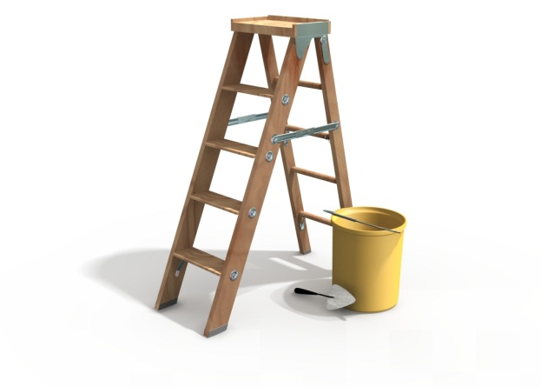
Value Them
Ask each Member what they think their Skill Sets and Challenges are, and then build on them!
Be Warm, Smile A Lot and Always say Hi!
Get To Know Each Member Individually
Call a Member by Name. We Love to Hear Our Name
Learn To Laugh, Smile, Add Humor Where Appropriate
Show That You Care. Let members know you care about their goals in the Club
Treat Others With Dignity And Respect
Promote A Positive And Encouraging Environment

Slide 10
The Warning Signs
Marked decline in meeting attendance and committee involvement among formerly active members is a sign of lost interest.
Although these members may have compelling reasons for reducing the amount of time they commit to the club, do not give up on them.
Handle such members with tact and consideration.

Slide 11
Reasons for Non-Renewal
Members don’t see value in
their membership and don’t feel valued
Club assumes a member will renew his/her membership
Renewal efforts applied only to specific groups or individuals
Not having good members activities to get new member started off on the right foot
Economics
Personal Circumstances
Loss of Interest

Slide 12

We Need Our Members
Make missing members feel valued and needed by asking them to take on a task that "only they can do," one where their experience truly counts.
Ask them to give just a small amount of their time to one particular project.
Explain that their contribution is very important.

Slide 13

We Value Our Members
Take time to say thanks.
Honor members with a luncheon, ceremony, award or certificate in recognition of their years of involvement and service.
A certificate of appreciation for a job well done on a specific project goes a long way.
Remember That Recognition Equals Motivation!

Slide 14
Celebrate Your Members
Recognize Accomplishments Outside the Club
Celebrate Life Successes
  Anniversaries
  Promotions
  Awards
  Marriages
  Births
  Etc.
Acknowledge Personal and Community Contributions
Make EVERYONE Feel Welcome

Slide 15
Personal Follow Up
Let a member know they are missed the first time they fail to attend a meeting or event.
Forward a "We missed you at the meeting" postcard message.
Call them on the telephone or write a personal note at the bottom of the next meeting notice.

Slide 16
Communicate
More engagement and improved communication with your members is a simple way of generating increased ‘brand loyalty’ towards your club, whilst adding value where you can should keep your members happy.

Slide 17
Go Back to the Well
Recruit lapsed members just as you would new prospects.
Sell the organization to former members.
Ask them what they enjoyed most about their participation in the past.
Keep questioning on a positive basis.
Emphasize the aspects of the organization the member is most likely to miss in allowing their membership to lapse.

Slide 18
Deal with Issues
Solve Conflict Promptly, Fairly, and in Private
Never Scold a Member
Treat everyone with Respect, Consideration and Appreciation
Practice Integrity, Dedication to Excellence, Respect For all Individuals and Service to the Member in all that you do
Keep a positive attitude; it increases energy and each member's self-esteem
Be Kind

Slide 19
Get Support From The Families
Hold a “Family” night to introduce the clubs to all members of their families. Hopefully this will encourage them to support the club member.
Encourage periodic spouse activities to help insure support at home.

Slide 20
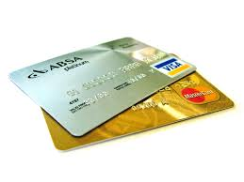
New Member Retention Ideas
Postcard invitations
New member services
“How’s it going?”
Buddy program
New member discounts
“Thank you for renewing”
Welcome all year long
PLASTIC – Accept Credit Cards
Welcome letter
New member kit
Welcome phone call
New member orientation or reception
New member survey
Publish names in newsletter and on Web Site
Spotlight Individuals

Slide 21
Long-term Member Retention Ideas
Feedback after meetings
Annual report
Committee involvement
Communicate in preferred manner
Anniversary letters
PLASTIC – Accept Credit Cards
Phone calls
Reward members who participate in membership drives
Add social events to activities. All business is dull!!!
Exit phone calls

Slide 22
Fill Your Bucket
Keep doing for Existing Members what you’ve done for New Members
Continue to convey to them that their membership and contributions are valued year after year
Provide ongoing attention, communication and involvement
Everyone is Important!!!

Slide 23
ACT NOW
Start working on your Recruitment and Retention Plan
Conduct Focus Groups
Find out Why People Join
Find out Why Members Leave
Be the Glue!
Loyalty is built by providing VALUE!
You need to consistently evaluate what you are doing well, what you could do better, and PLAN – DO – CHECK – ACT.
REMEMBER – Members don’t need us – We NEED them!
Plug the Holes in your Bucket!

Slide 24
Questions
Your Comments or Ideas
Things that have worked for you
Where there was a HOLE in your Bucket, Make your Bucket WHOLE

