Slide 1
; ;

Slide 2
Your District 12 Delegation dressed for the Opening Ceremony

Slide 3
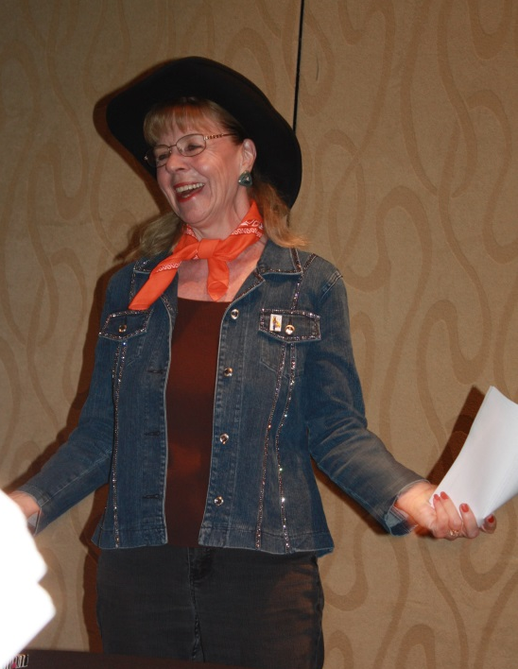
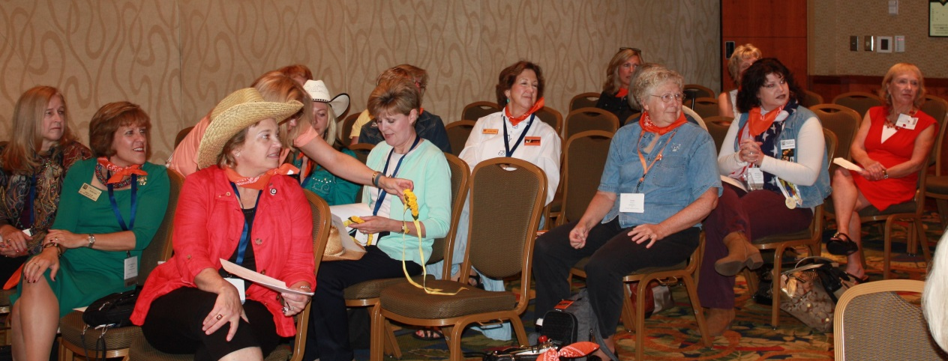
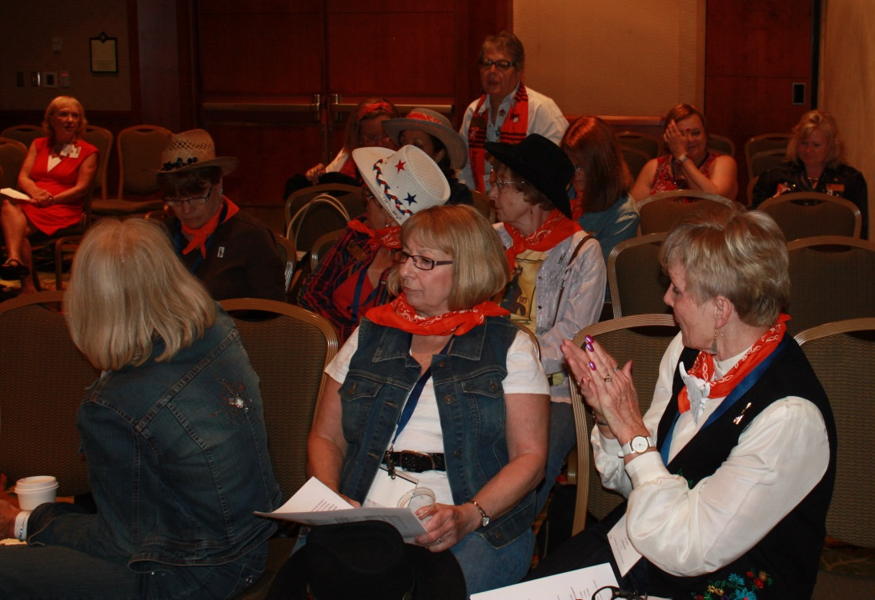
District 12 Meeting
(followed by the Open Forum)

Slide 4
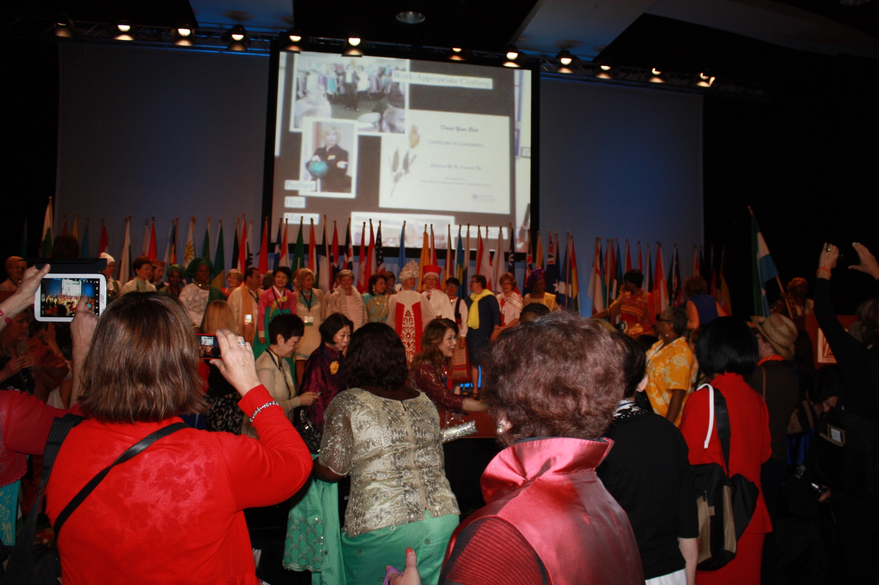
2014 Opening Ceremonies

Slide 5
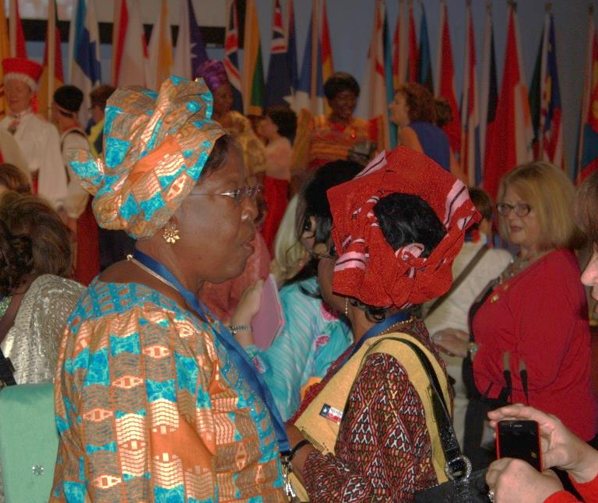
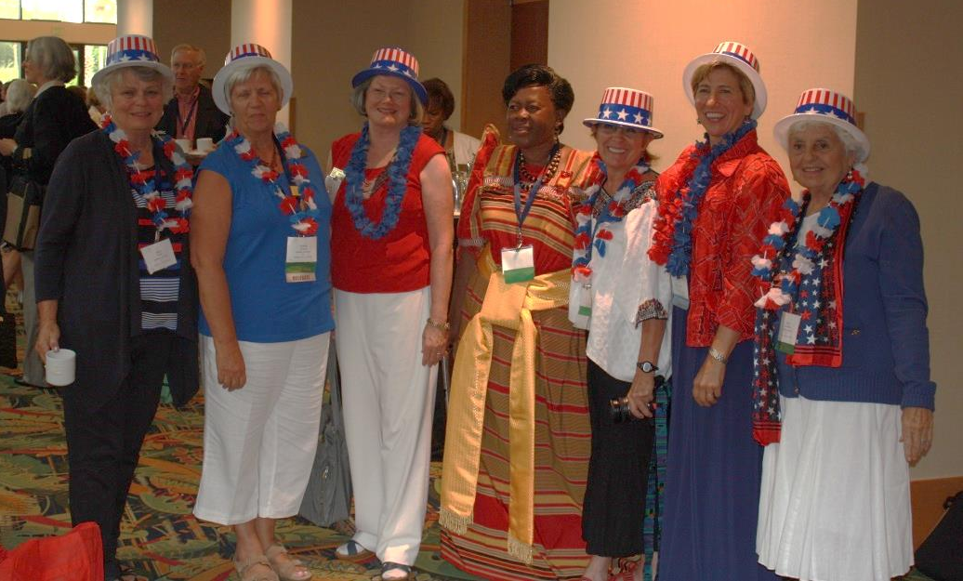
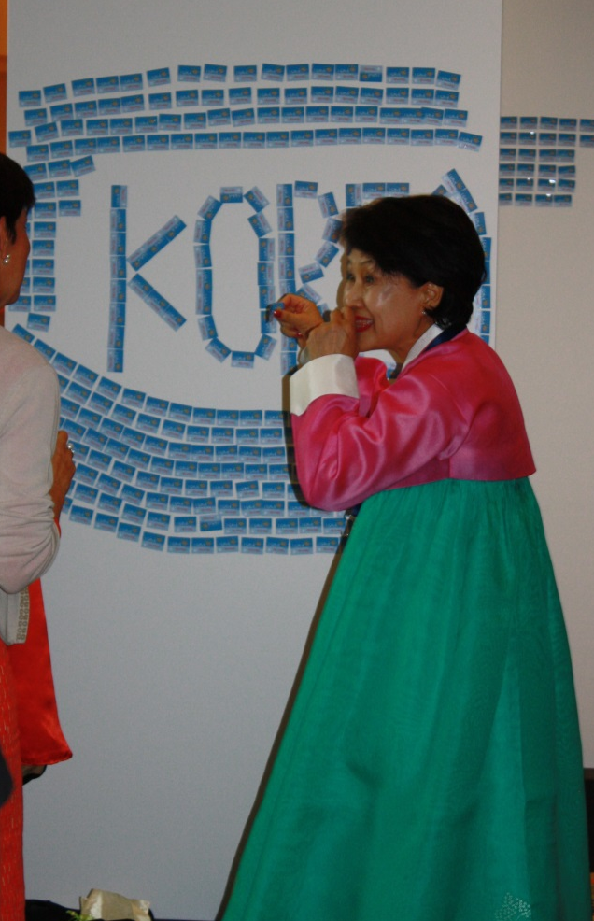
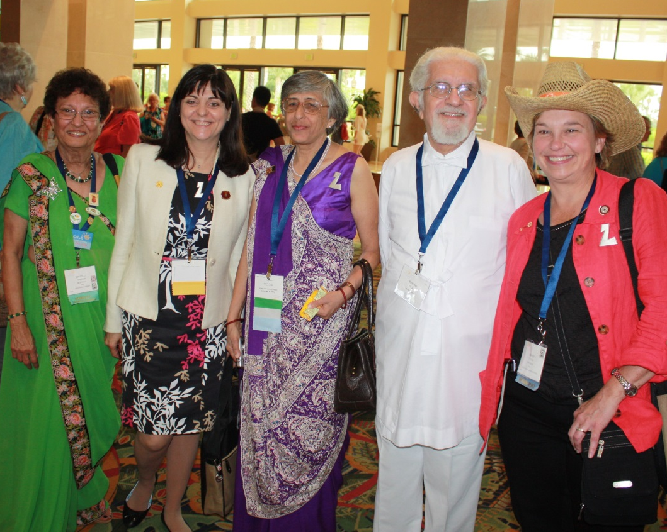
Afterward

Slide 6
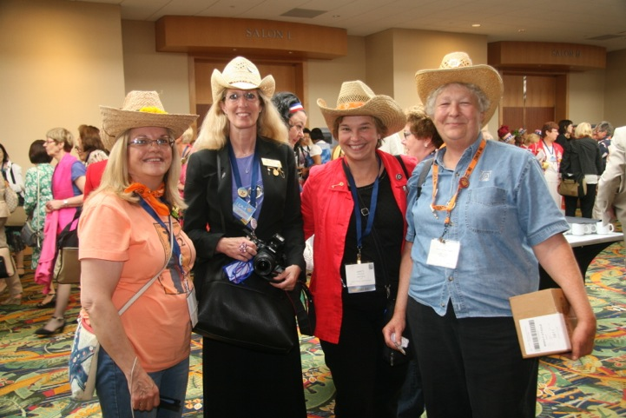
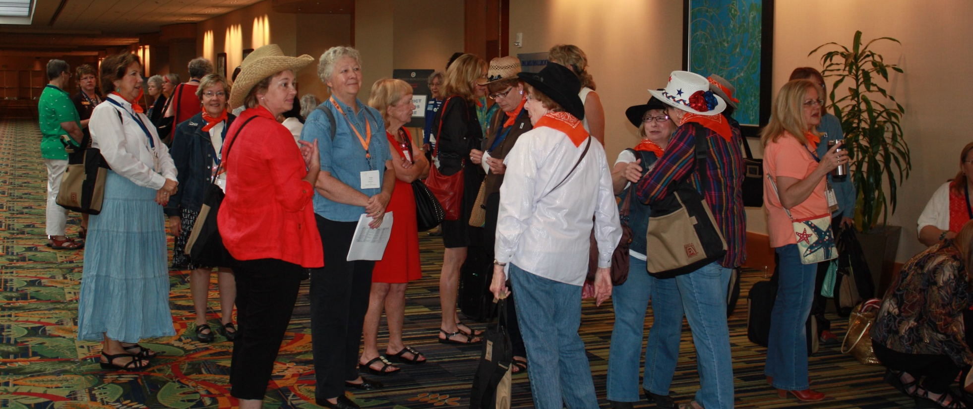
Kay was back in this  room helping to host Mme Mlambo-Ngcuka
Other D12 Gatherings after the Ceremonies

Slide 7
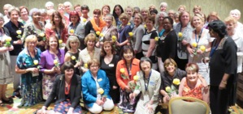
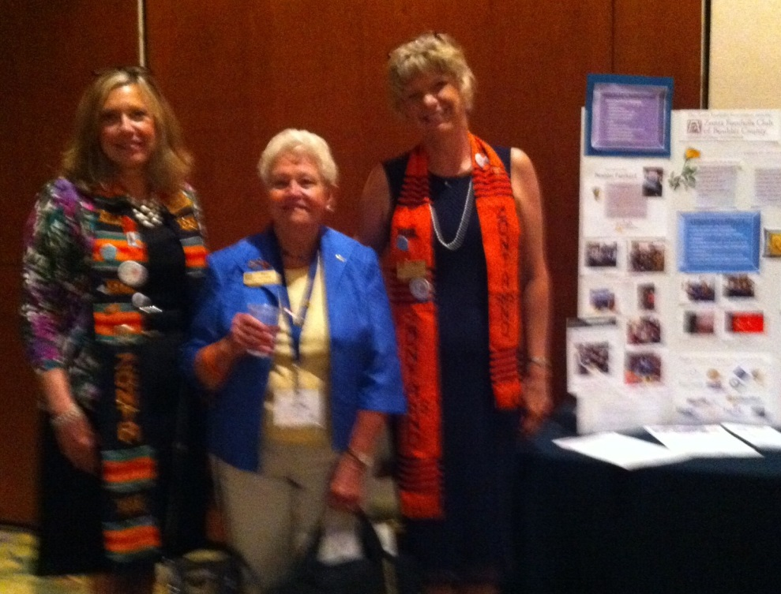
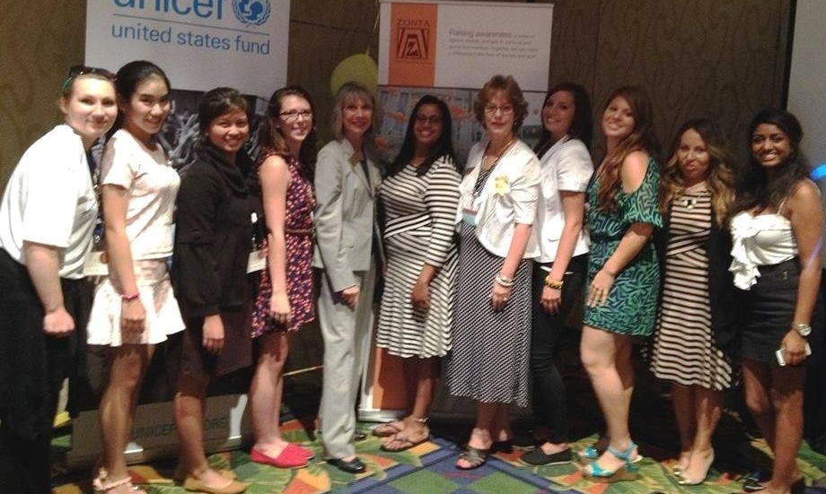
Other gatherings throughout Convention…
ZI Directors,
& ICCs…
D12 @ Trade Show’
Golden Zs’ first involvement in a ZI Convention

Slide 8
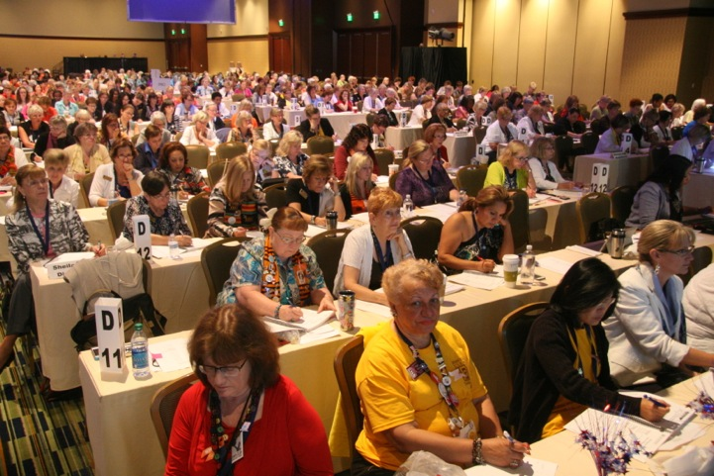
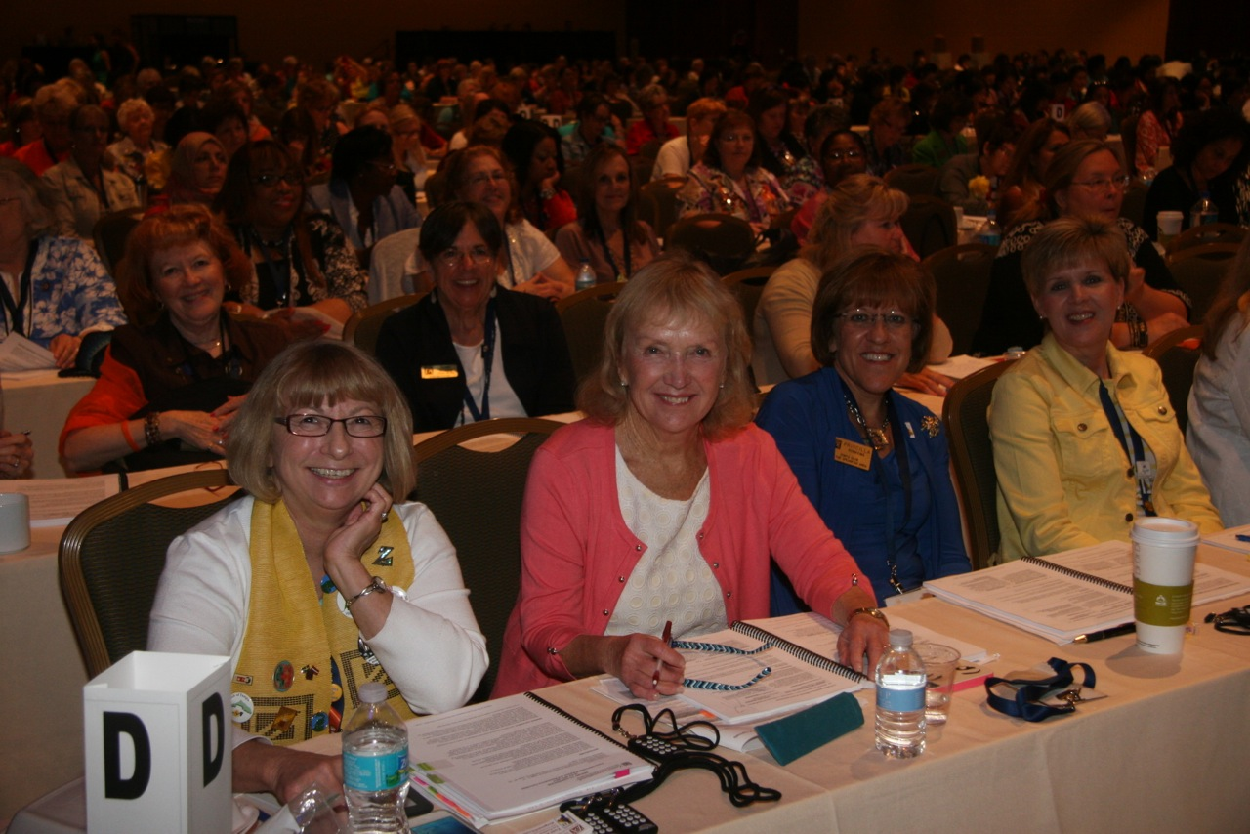
Trade shows,
Int’l Cmte Meetings, & Discussion groups during BB Lunches.
Business Sessions:
Status--2012-14 Biennium
Nominations & Speeches
Election of Officers
Bylaws—71 motions!
Approving 2014-16 Goals
Approving 2014-16 Int’l Projects

Slide 9
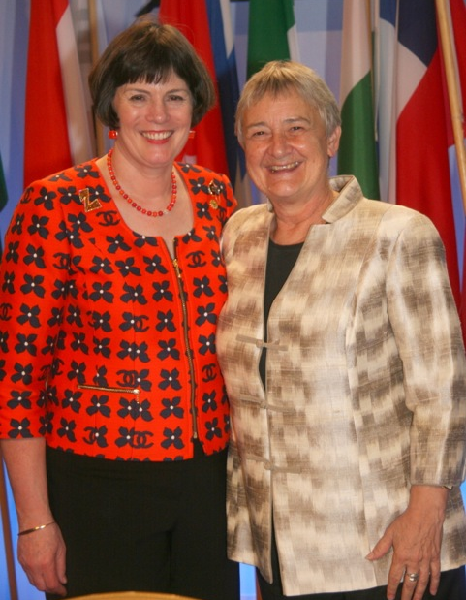
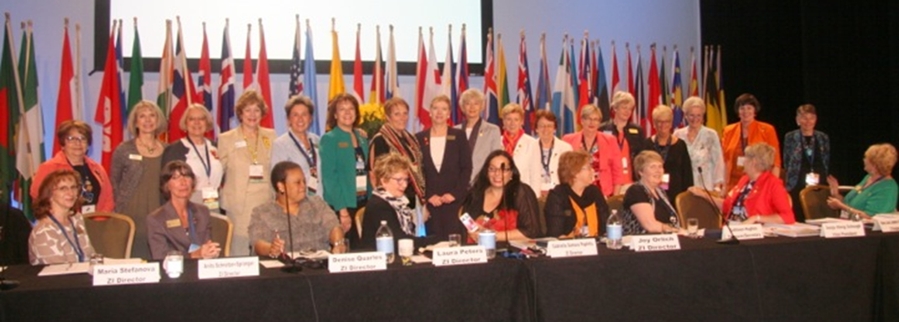
Highlights & important matters:
Honorary Zontians-
Scholarship winners-
Accomplishments of past biennium
Election of new Officers & Directors

Slide 10
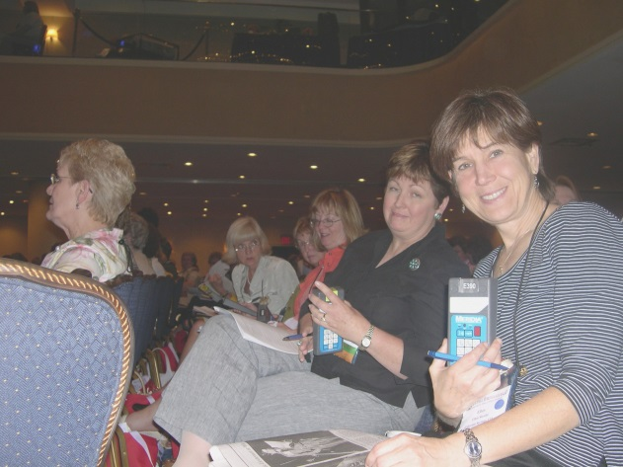
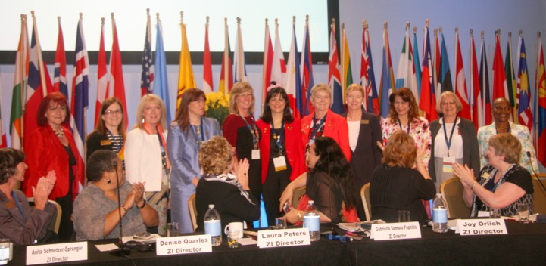
The 2012-14 Board introduces the 2014-16 Board.
Photo of D12 Delegates from 2004 Convention voting late in day…
Bylaws…
Bylaws…
Bylaws…
After hours of voting, let’s now note some changes of interest.

Slide 11
Biennial Goals 2014-2016
Focus Areas for the biennium -- w/ 100% delegate approval
District & clubs should develop their own biennial goals adapted to local conditions. (See handout.)
2014-2016 International Service Projects and ZISVAW Projects:
Eliminating Obstetric Fistula in Liberia in partnership with UNFPA
HIV-Free Generation in Rwanda in partnership with US Fund for UNICEF
Gender Responsive Schools in Vietnam in partnership w/ UN Trust Fund
Delaying Early Marriage in Niger in partnership with UNFPA
Voices Against Violence in 12 Countries in partnership with UN Women

Slide 12
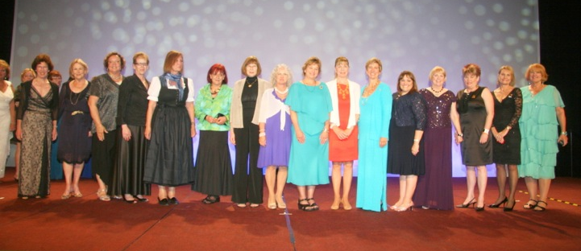
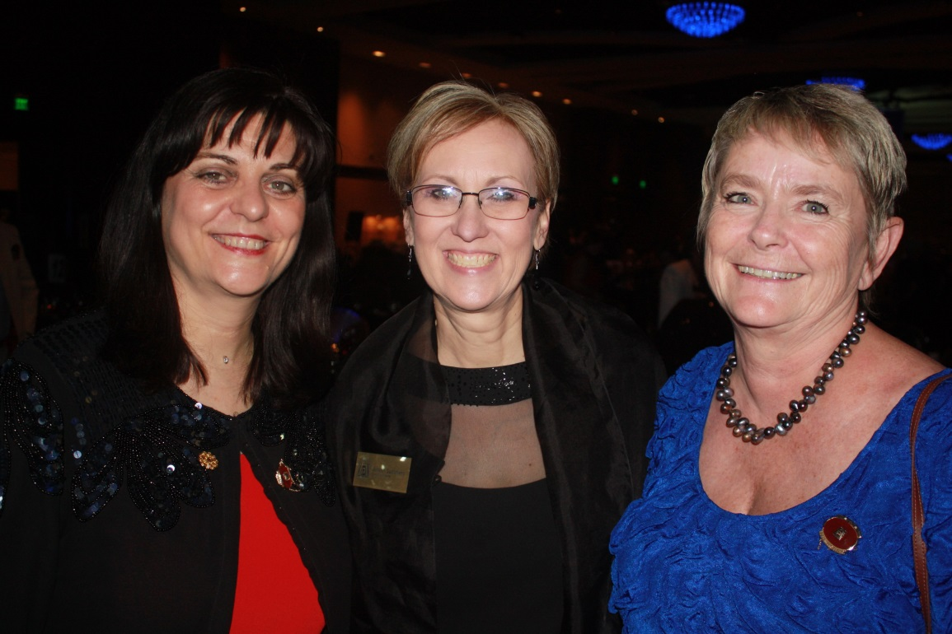
Some outgoing & incoming Governors (including Marcy & Sheila) & ZI Leadership 2014-16 MariaJosé, Allison, & Sonia

Slide 13
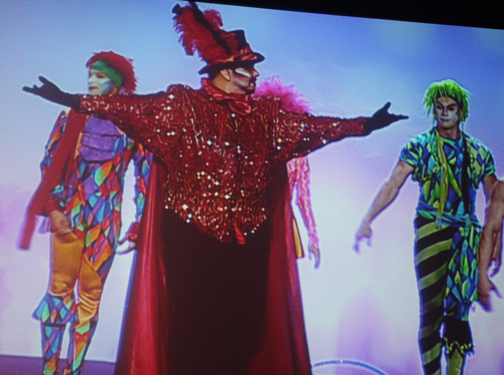
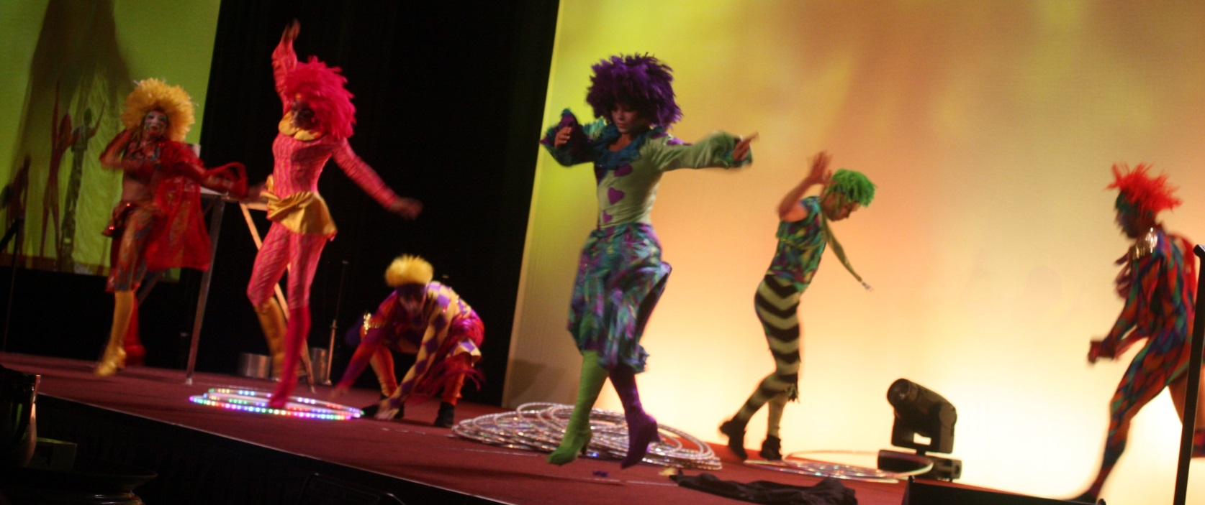
& last but not least …Cirque de Soleil…

Slide 14
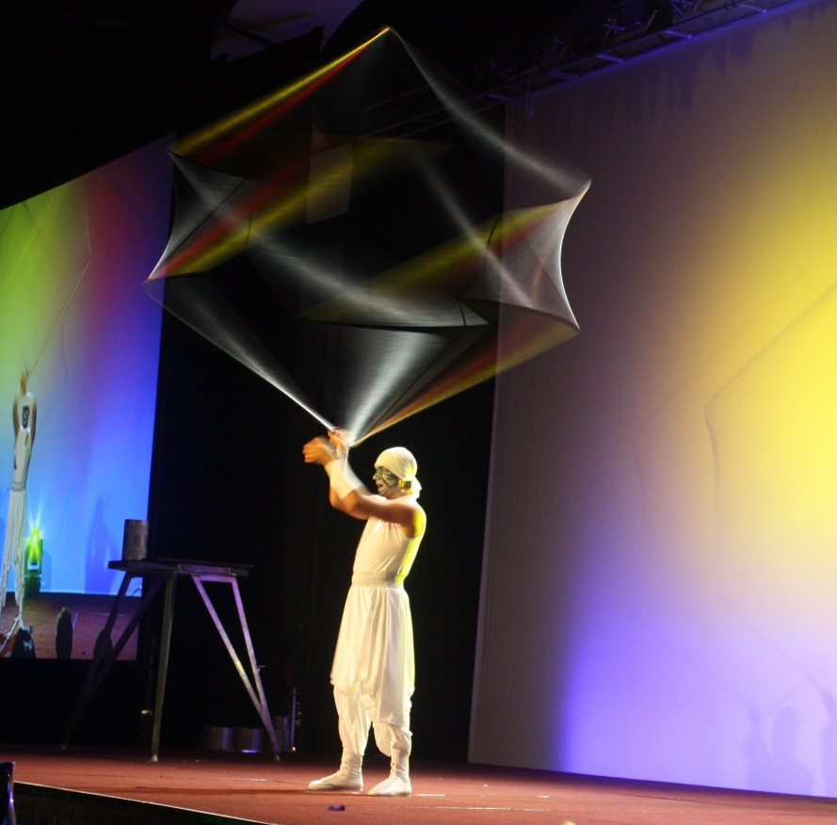
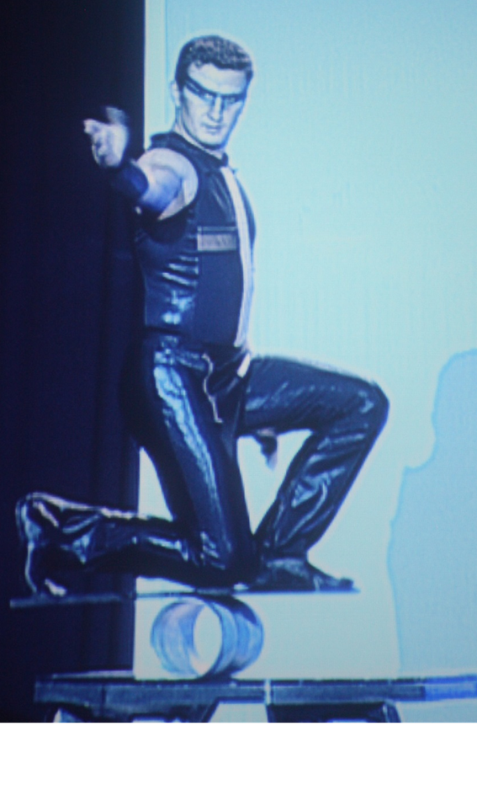
…Cirque de Soleil…

Slide 15
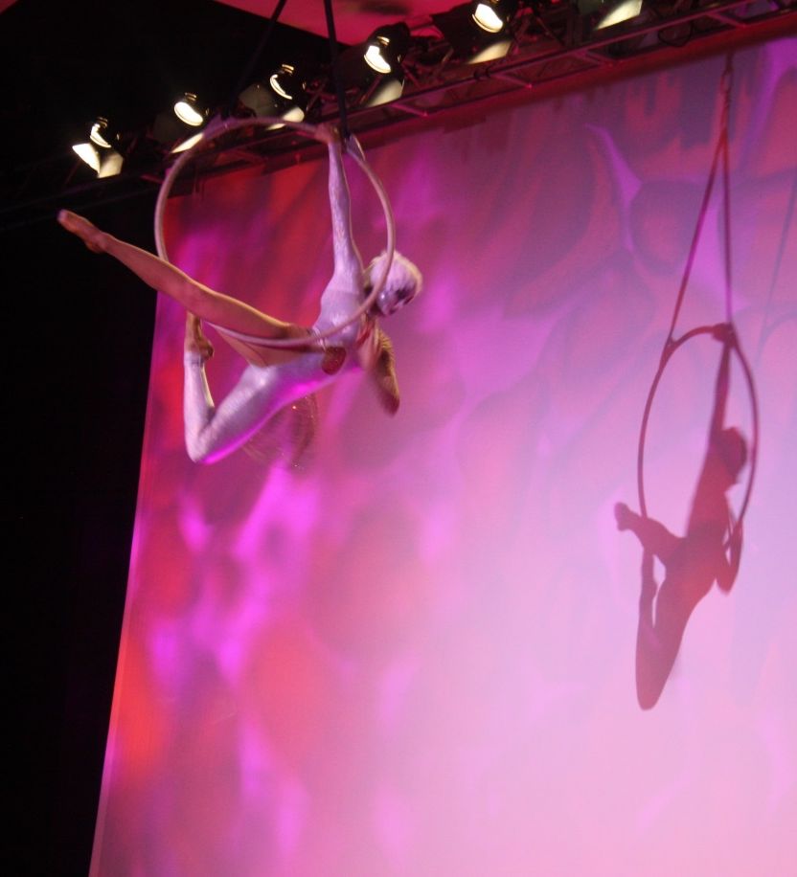
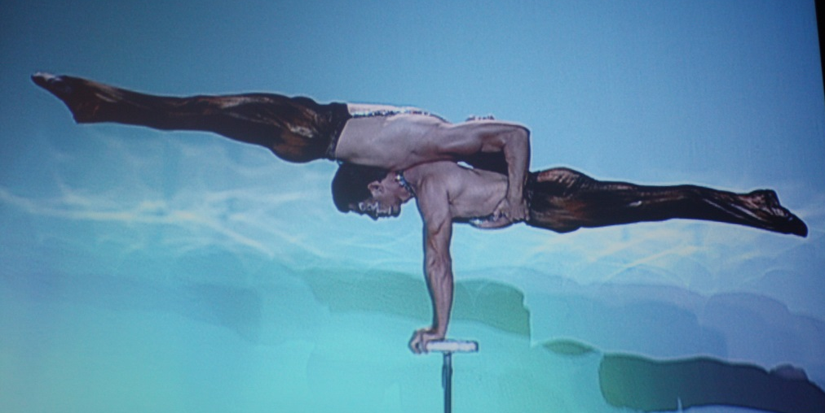
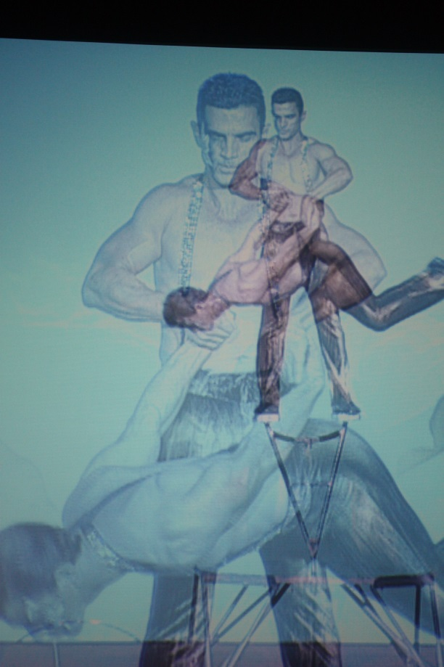
…Cirque de Soleil
The end.

