Slide 1
Zoom District-wide Virtual Area Meeting April 25, 2020
Governor’s Message

Slide 2
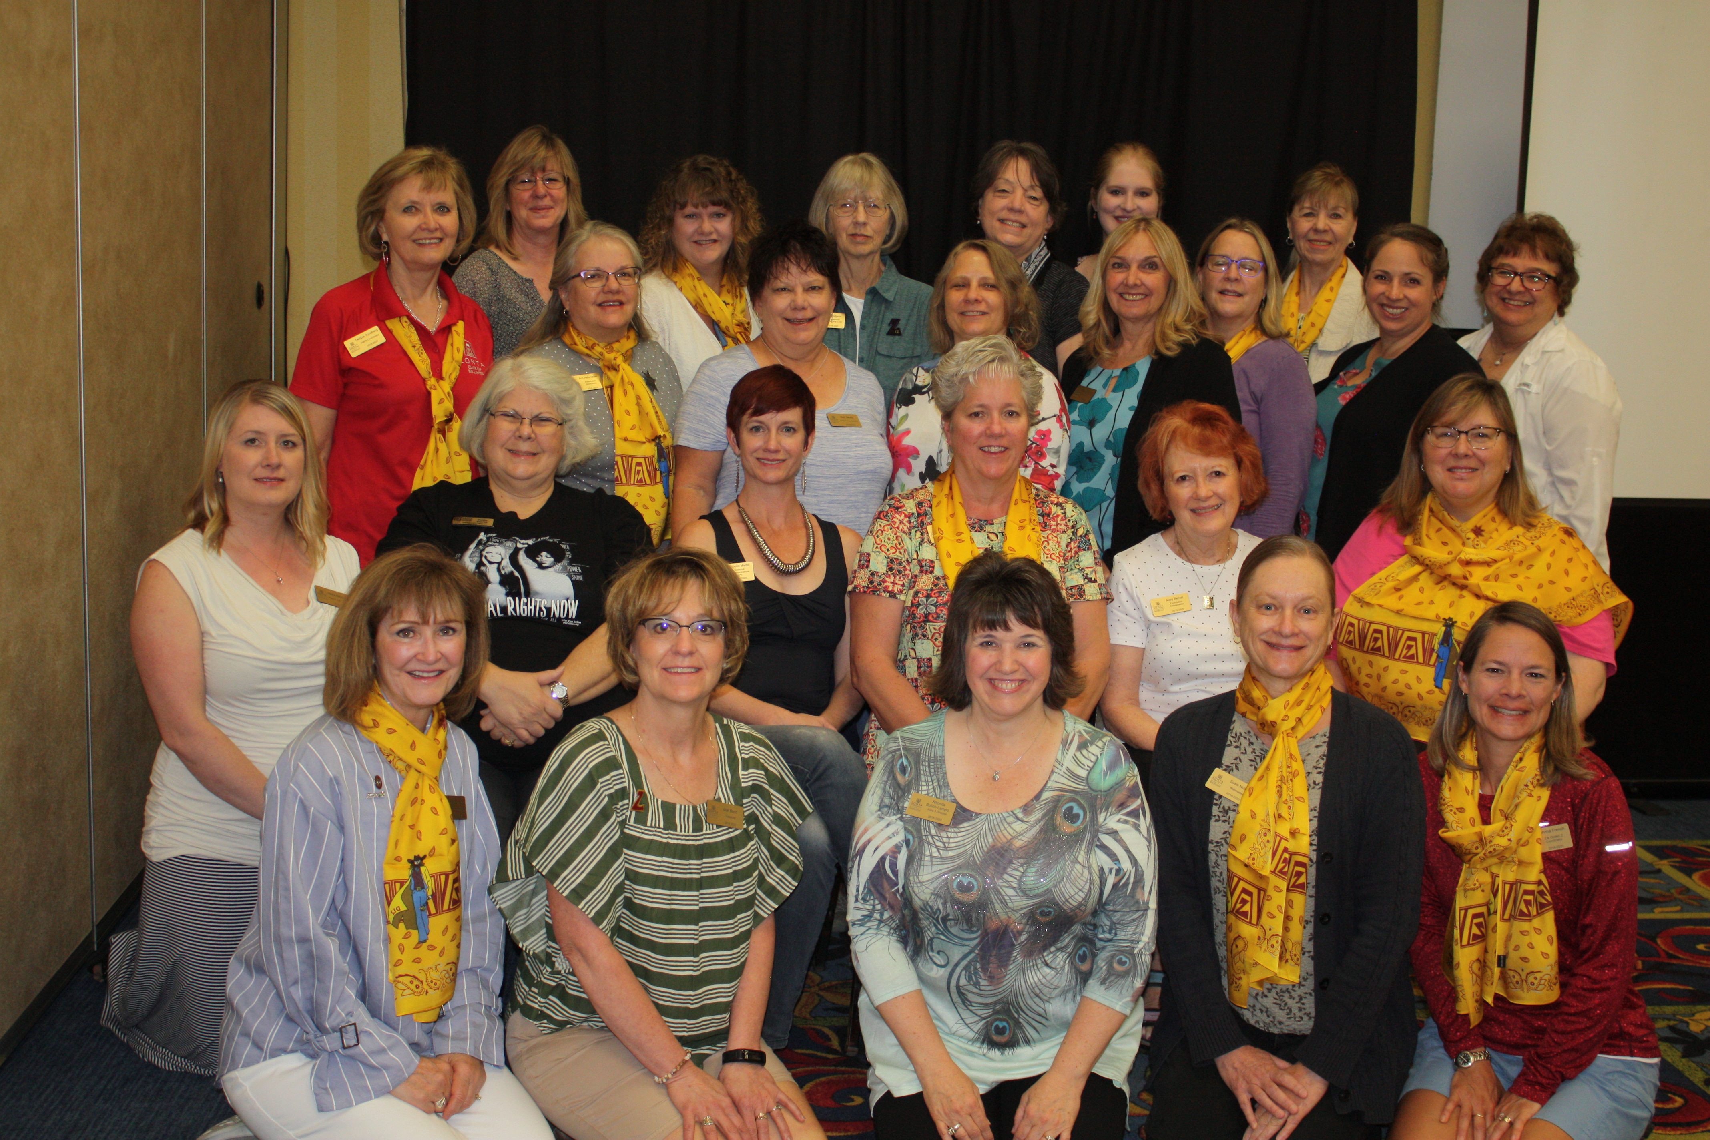
Welcome to Our Meeting
Thank you District 12 Leaders

Slide 3
District Leaders in 2020 - 2022
Governor-Elect Ann Hodgson
Lt. Governor Bridget Masters
Treasurer Jan Kirch
Area Directors:
Area 1- Debbie Sundberg
Area 2 -Tasha Bauman
Area 3 - Deb Beatty and
Area 4 – Sonya Bergeron

Slide 4
Speaking of New Leaders…
Club Annual Meetings
New Club Officers
Board Retreats
Summer Club Get -Togethers

Slide 5
Now on to the Future
Reminders for the next few months
Club Membership Records and ZI Dues – online. Due May 1.
District dues from clubs due to Jan Kirch by May 1.
Club Officer Form – Due June 1
Elections and Voting on Zonta business – more will follow when platform is confirmed. Each club – one delegate and one alternate. Submit by May 15. Should receive soon.
Slate of Candidates – available online. Choose as a club.
Proposed Amendments to bylaws, rules of procedures, and resolutions – Renee will discuss.
Proposed Zonta International Budget – Bridget will discuss
2020 – 2022 Biennial goals and international projects.

Slide 6
Proposed Biennial Goal 1
Goal 1. Programs and projects increase our impact and effectiveness in helping women and girls.
Women in Technology Scholarship continues
YWPA and JMK programs will be studied and evaluated
ZI will publish statements on issues impacting the lives of women and girls e.g. human trafficking, climate change etc.
Clubs encouraged to participate in at least one advocacy activity each year.

Slide 7
Proposed Biennial Goal 2
Goal 2. Membership – maintain Zonta’s visibility globally and locally
Focus on membership retention
Districts hold at least one event per year with current education award winners and awardee alumnae
ZI will support current and future leaders through Zonta professional development and mentoring tools tailored to individual club needs

Slide 8
Proposed Biennial Goal 3
Goal 3. Financial Resources – essential for maintaining and growing our ability to make a difference in the lives of women and girls.
Donations to the ZI Foundation meet or exceed the biennial fundraising goals
Donations to the endowment funds continue to be made towards achieving the long term goal of US $10 million
ZI Foundation will expand awareness and visibility of the focus of Zonta’s global charitable efforts by doing business as “Zonta Foundation for Women”

Slide 9
Proposed International Service Projects
Adolescent Girls’ Health and Protection in Peru.
US$1,000,000 to UNICEF USA
Improve services to respond to adolescent girls’ health and prevent violence (especially gender-based) is schools in the regions of Huancavelica and Ucayali.
Let Us Learn Madagascar – Empowering Girls Through Education: Phase 3
$US500,000 to UNICEF USA
Address education and gender inequity in Madagascar through approaches targeted toward girls.

Slide 10
Proposed International Service Projects
Ending Child Marriage – A Program to Accelerate Global Action: Phase II
$US1,500,000 to UNFPA and UNICEF via UNICEF USA
Elevate the voice and agency of adolescent girls by empowering marginalized adolescent girls through life skills and knowledge building and promoting gender equity in girls’ families and communities
Increase resources and opportunities for adolescent girls and their families by strengthening education, health and child protection systems, and addressing the ways that poverty drives the practice of child marriage
Enhance legal and political action to prevent child marriage, and to support married, divorced or widowed adolescent girls

Slide 11
Final Reminds
Club Annual Report to Deedee by May 8
Copy of the ZI Club Officer Form to Deedee

Slide 12
Thank you!
Questions
Governor Deedee Boysen
boysen.deedee@gmail.com

