Slide 1
Zonta International Foundation
Projects and Programs
District 12 Area 3 Meeting
January 24, 2015

Slide 2
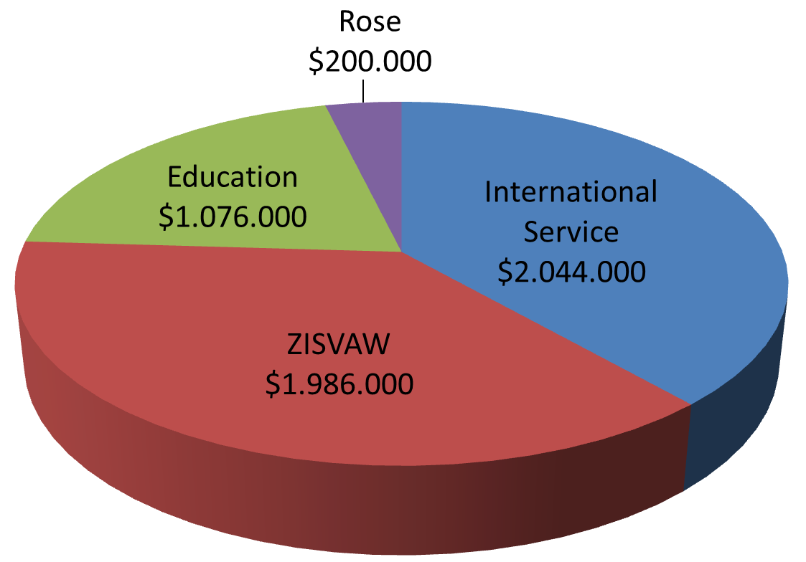
2014-2016 Fundraising Goal
US$5,306,000
ZISVAW: Zonta International Strategies to End Violence Against Women
Notes:
For the current biennium our fundraising goal is US$ 5,306,000. These funds will be allocated to support projects during the 2016-2018 biennium.
The 2014-2016 fundraising goal is $200,000 more than the US$ 5,101,000 that was raised during the 2012-2014 biennium, so we have some work to do!

Slide 3
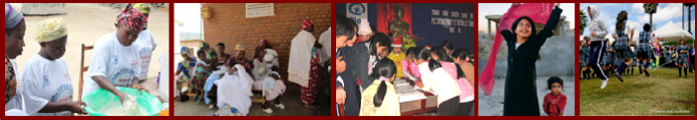
International Service & ZISVAW Projects
Education and Leadership Development Programs
2014‐2016 Proposed Projects
Notes:
At the 2014 Convention, Zontians made the decision that sustainable change
can be achieved through awareness and prevention of root causes via education.
During the 2014-2016 Biennium, and with Conviction, Commitment and
Courage, we will:
• Empower women and help them to reach their full potential through effective
mission-focused performance, lasting impact of programs and projects, and
membership growth.
• Strengthen our leading role in women’s issues through active participation in
the Beijing 20 process, launched in May 2014 as a defining framework for
change, and in the UN Post-2015 Agenda which represents the intensification
of the efforts of the global community to accomplish the eight Millennium
Development Goals.
• Address root causes and focus on prevention through education to change
attitudes in men and women.

Slide 4
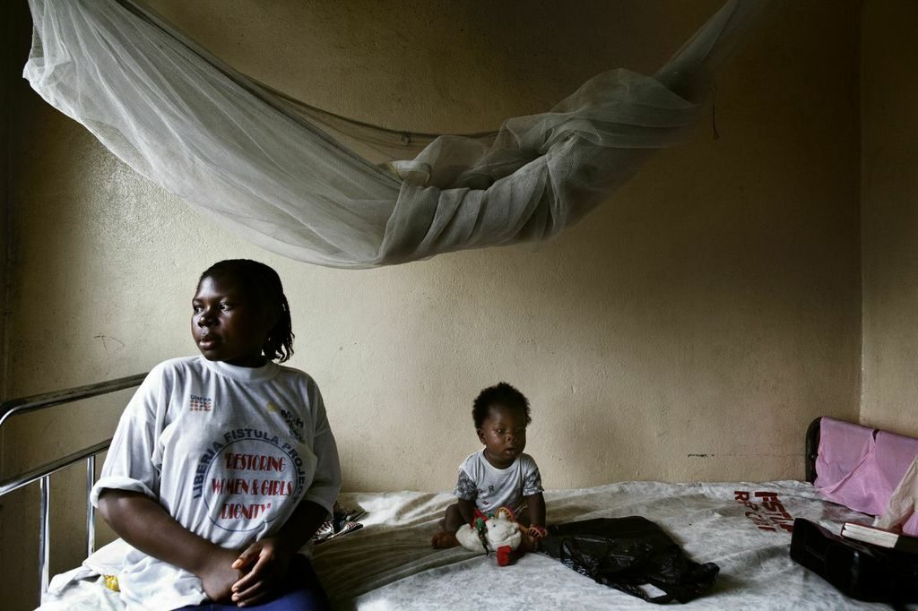
Eliminating Obstetric Fistula in Liberia
US$600,000
Goals:
Help eliminate obstetric and traumatic fistula and reduce maternal mortality, morbidity and sexual violence against women in Liberia
Improve the health and socio-economic status of over 400 women and girls through quality surgical and non-surgical treatment for obstetric and traumatic fistula
Notes:
The cost of one fistula surgery and post-operative care is only US$675. The cost of social rehabilitation for a fistula survivor is US$1,300.

Slide 5
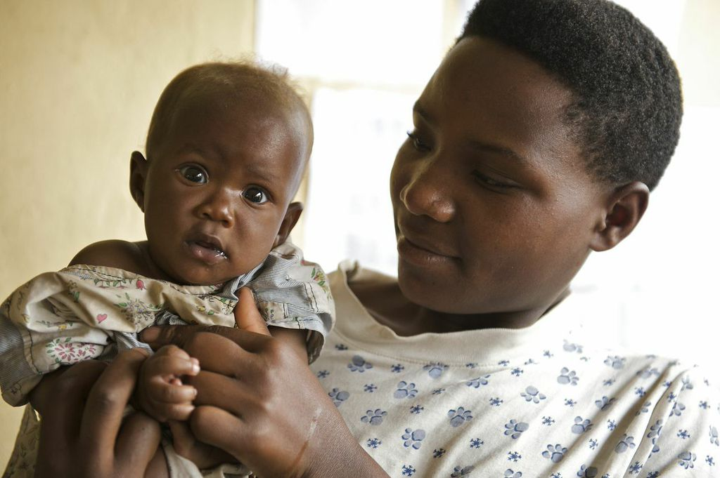
HIV-Free Generation in Rwanda
US$800,000
Goals:
To contribute to a nation free of AIDS and build an HIV free generation.
To support the national scale-up strategy for One Stop Centers
To invest in community-based prevention of violence against women and children
Improve access to HIV prevention and care in underserved and vulnerable populations
Notes:
Rwanda’s goal was to reduce HIV transmission from HIV infected mothers to their children by 2percent by 2015. Currently Rwanda has a1.36 percent transmission rate among infants of 6 weeks of age. With Zonta’s support , Rwanda is on the right path to a generation born free of HIV .

Slide 6

Gender Responsive Schools in Vietnam
US$644,000
Goals:
To create a school environment for adolescent girls and boys across Hanoi that is free from gender-based violence
Promote gender equal norms and respond to gender-based violence in and around 20 schools in Hanoi

Slide 7
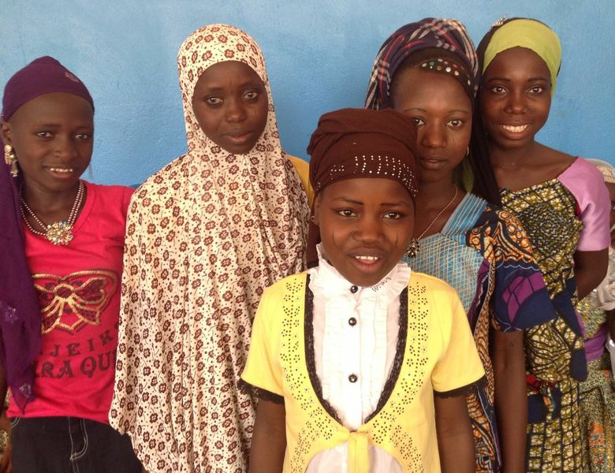
Delaying Early Marriage in Niger
US$1,000,000
Goals:
To reduce early marriage and early pregnancy in four regions of Niger
Reach 25,000 adolescent girls over 2 years; 400,000 members of their community will benefit from increased awareness.

Slide 8
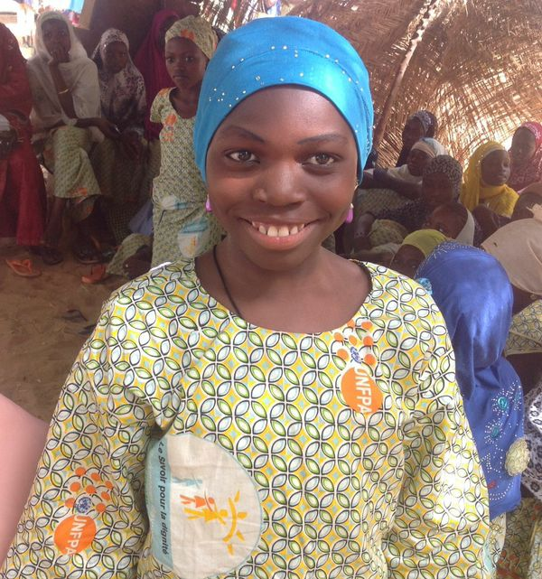
Delaying Early Marriage in Niger
Adolescents will:
Develop health, social, and economic assets
Know their rights and be in a stronger position to defend them
Be safer and have a measure of protection against violence
Have the basic tools required to lead fuller lives as adults
Be able to actively participate in the socio-economic development of their communities.
Notes:
Education is the key to prevention. Adolescent girls will receive literacy and financial literacy training and age appropriate life skills education. Girls will also be assisted in enrolling in school and have access to mentors and women leaders.

Slide 9
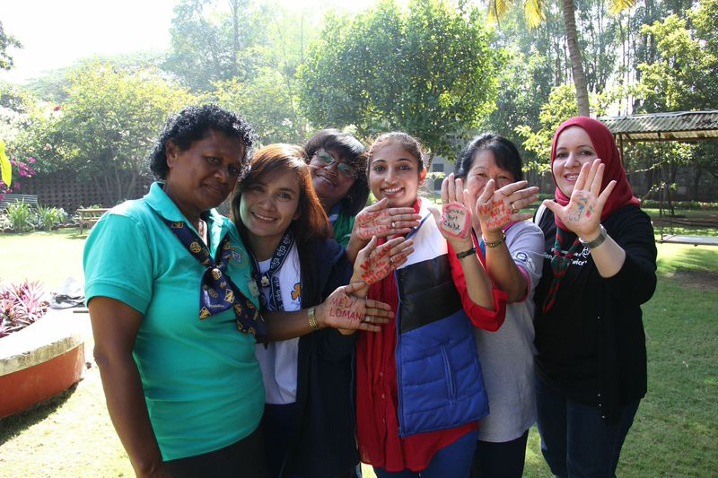
Voices Against Violence
US$986,000
Goals:
To prevent and reduce gender discrimination and violence against women and girls through non-formal education and youth engagement and leadership
Increase awareness and knowledge of gender based violence through non-formal education activities
Develop action plans for participants to roll out the curriculum
Notes:
This is a non-formal education curriculum for the World Association of Girl Guides and the Girl Scouts aimed at ending violence against women and girls. Members of the girl guide/girl scout movement can earn a badge by completing six sessions from a set of age appropriate activities.

Slide 10
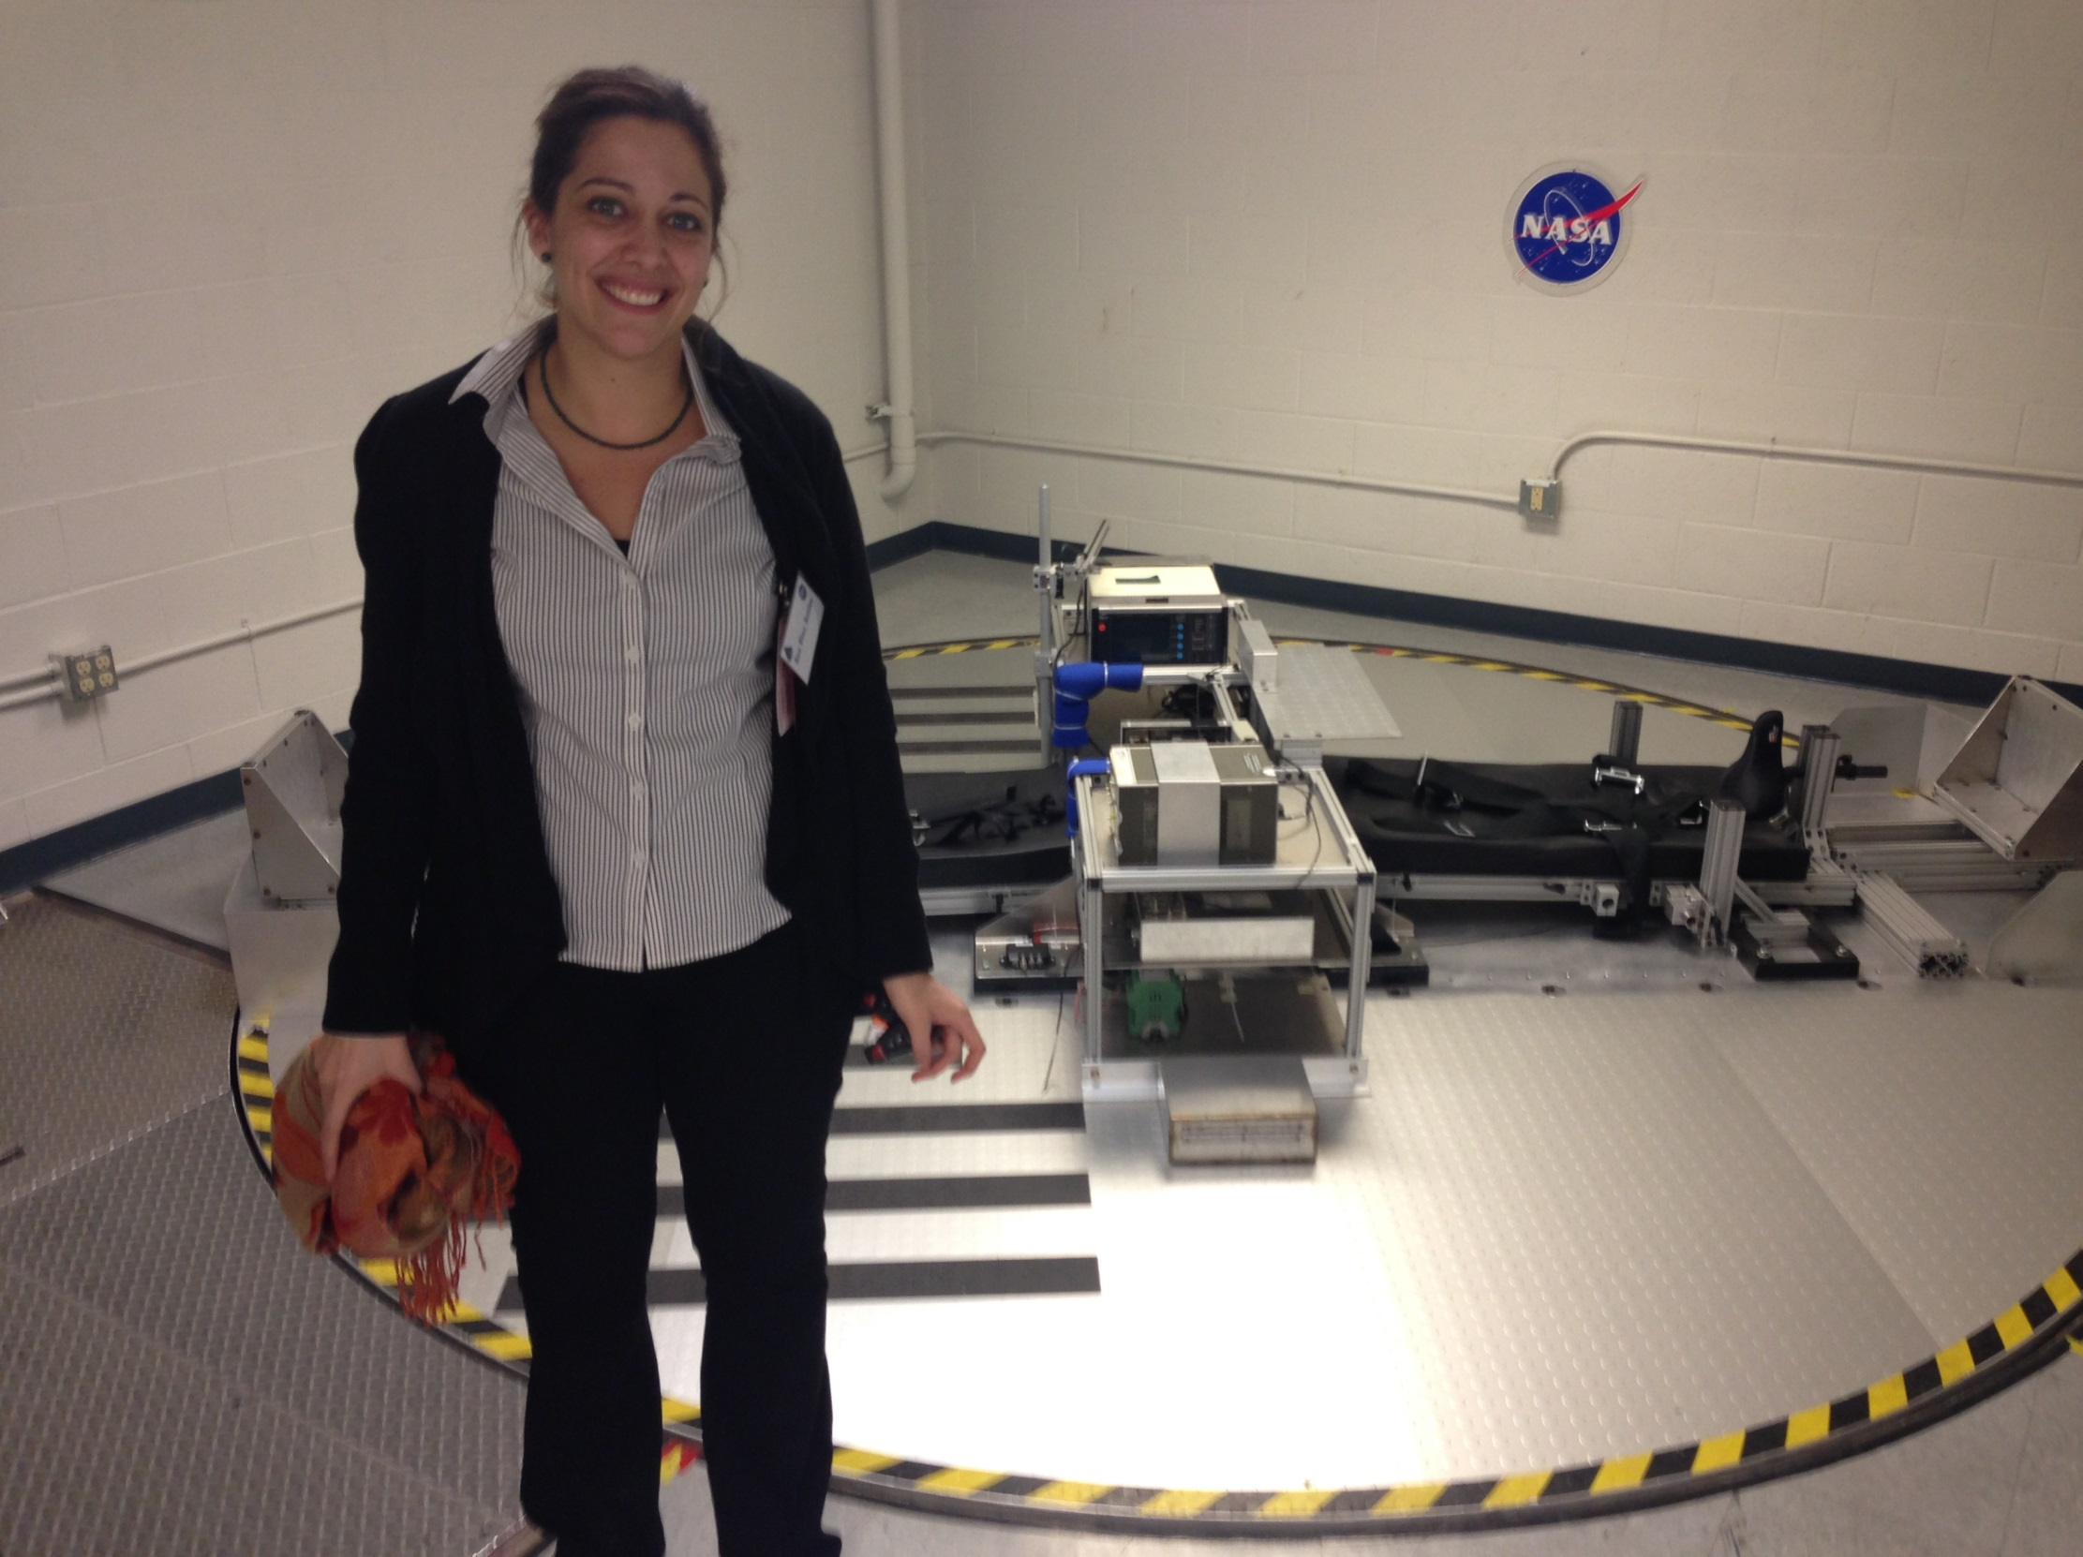
Amelia Earhart Fellowship Fund
US$700,000
Thirty-five, US$10,000 Fellowships are awarded each year to recipients from all over the world
Notes:
Since the program's inception, Zonta has awarded 1,438 Amelia Earhart Fellowships, totaling more than US$8.6 million, to women from 70 countries.

Slide 11

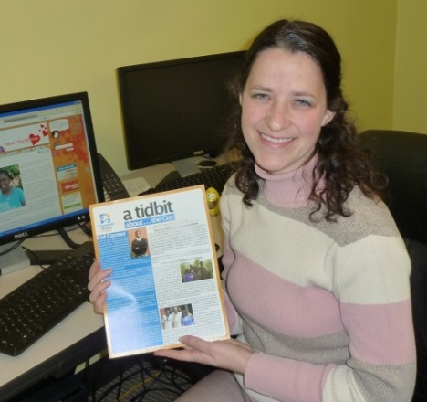
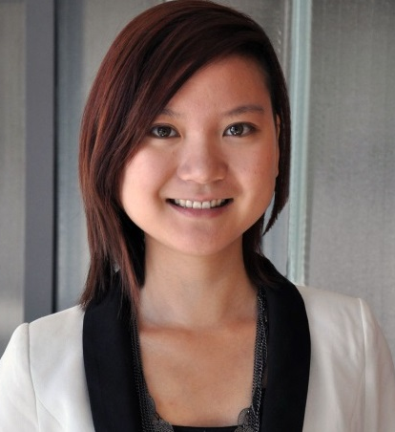
Jane M. Klausman Women in Business Scholarship Fund
US$232,000
Twelve international scholarships of US$7,000 each
Thirty two district/region scholarships of US$1,000 each
Notes:
Since 1998 Zonta has awarded 357 scholarships totaling almost US$700,000 to women from 47 countries.

Slide 12
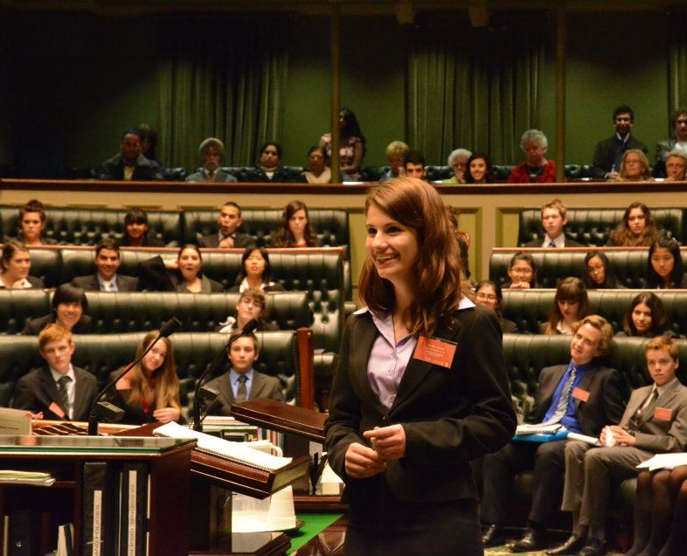
Young Women in Public Affairs Award
US$144,000
Ten international awards of US$4,000
Thirty two district/region awards of US$1,000
Notes:
Since the program's inception, Zonta has given 721 awards (includes international awards) totaling US$621,750 to 629 young women from 51 countries.

Slide 13
